Slide 1
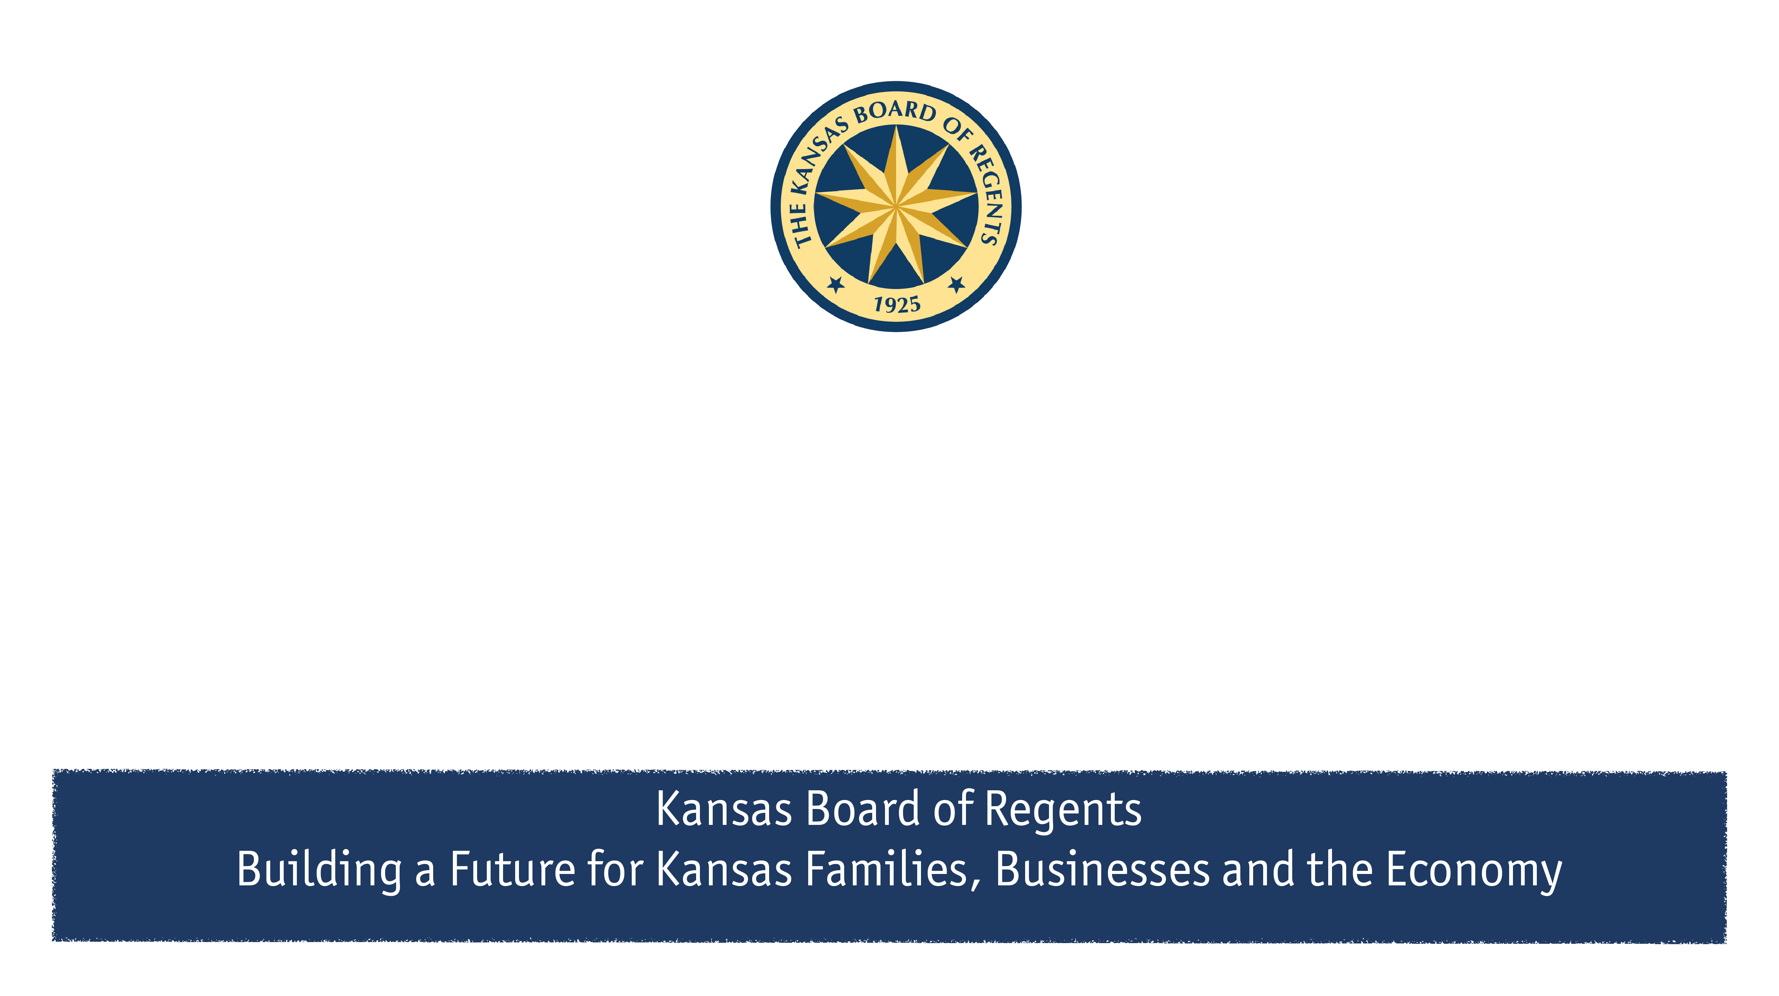
Kansas Comprehensive Grant Q&A
Leah Nicholson, Director of Student Financial Assistance

Slide 2
What makes up my allocation?
Legal Base Amount: This portion of your allocation is written in statute and was established in 1998-99. It cannot be adjusted by anything other than a change in statute. Must follow KCG criteria when awarding.
Enhancement Funding: This portion of your allocation is determined by an agreed upon formula within your sectors that is based on the data your institution provides each Fall. Public institutions use a formula that weights students with the highest financial need. Independent institutions use a formula that distributes funding to create an equal percentage of funded/unfunded applications at each institution based on the maximum award amount. Must follow KCG criteria when awarding.
State Match Funding: This portion of your allocation was the new funding given in fiscal year 2023. It was distributed among institutions based on your institution’s Pell eligible student count (both in-state and out-of-state) compared to the overall Pell count among eligible institutions in the state. This funding requires institutions to match their allocated amount $1 for $1. Must follow KCG criteria when awarding.
Institutional Match. The non-state money that the institution must raise/identify to match the state match funding. Only criteria is student must have financial need as defined by the institution.

Slide 3
Institutional Funds Rules to Follow:
The amount an individual institution will match $1:$1 would be equal to the amount of state match dollars an individual institution is allocated each year.
  Moving forward, this may be the ENTIRE appropriation – more to come on this later.
Institutions will award institutional match amounts to students they deem eligible (who may or may not be eligible for KCG funding), as long as the institutional match is awarded to students who demonstrate financial need. Financial need is determined by the school.
Institutions can use both new and current institutional funds to count towards their institutional match, including institutional scholarships, institutional grants, and earnings on endowed funds. All institutional match funds should be a cash match – meaning actual dollars must be present in the transaction behind the award.

Slide 4
Let’s talk about financial need…
Examples I’ve received from other schools on how one might be defining financial need are:
Typical federal methodology for financial need (COA – EFC)
Using a combination of indicators such as income and family size
Targeted aid that addresses gaps between a student’s aid and what they will owe rather than only the gap between EFC and COA
Emergency grants
Bridge grants (past due balance awards)
Completion grants (exhausted aid awards)
“Come back and finish”/stopped out student awards

Slide 5
State Fund Rules to Follow:
State match funding (and base and enhancement fudning) must be awarded with the same eligibility criteria and awarding rules as regular KCG funds.
  Kansas Resident
  Be an undergraduate, degree-seeking student – pursuing first degree
  Enrolled full-time at an eligible institution (12 credit hours)
  Demonstrate financial need using the federal aid methodology
  Meet Satisfactory Academic Progress (SAP)
  Can be eligible for up to 8 semesters (10 if enrolled in a designated 5-year program)
  Priority is given to eligible applicants that file the FAFSA by April 1
    Institutions may determine their own priority dates for KCG.
  Public institutions may only award students with up to a 6500 EFC. (This is being discussed by directors in May).
State match funding should not be awarded until it is matched.
If an institution is not able to match their full required amount in any given year, any unmatched state funding at an institution would be returned and redistributed the next academic year to all institutions based on the distribution formula for state match funding.
If state match funding has been matched by the institution but has not been spent, institutions will be able to keep their unspent state match allocation and roll it over to award for the next academic year.

Slide 6
What counts as a match?
Endowments created for student financial aid awards:
  Endowed accounts can have yearly earnings count towards the total institutional match funding amount each year. This is the portion that can actually be spent towards student financial aid awards.
  The corpus/investments made to an endowment will not count towards the match requirement, as this portion cannot be spent on student financial aid awards. However, new investments made into currently existing endowments, or new endowments created will eventually result in earnings that will count towards the match requirement each year.
  Awards made from the institutional match must be made to students with financial need. Financial need is determined by the school.

Slide 7
What counts as a match?
Donations/gifts raised towards student financial aid awards:
  Awards made within the academic year being reported from donations/gifts can count towards institutional match.
  Awards made from the institutional match must be made to students with financial need. Financial need is determined by the school.

Slide 8
What DOES NOT count as a match?
Institutions cannot use the following as an institutional match:
  Non-institutional scholarships/grants
  State awards (state scholarships, KCG, etc.)
  Federal financial aid (such as Pell grant, SEOG, Work Study, TEACH, etc.)
  Non-cash matches (Example: waivers or tuition discounts that do not result in the exchange of funds necessary to finance the costs of student attendance)
  Loans

Slide 9
What if we don’t match?
If an institution is not able to match their full required amount in any given year, any unmatched state funding at an institution would be returned and redistributed the next academic year to all institutions based on the distribution formula for state match funding. This would ensure that the full state match funding is eventually matched and spent among the institutions.
If state match funding has been matched by the institution but has not been spent, institutions will be able to keep their unspent state match allocation and roll it over to award for the next academic year.

Slide 10
Reporting Your Match
Institutions will be required to report to the Board of Regents how they matched their KCG allocations by July 31st each year. For example, institutions will report match identified during the 2022-2023 academic year on July 31, 2023.
Institutions will need to provide the following information in that report:
  The source of the funds (earnings from an endowed fund, one-time donation, etc.); and
  The aggregate amount used from each fund towards the match; and
  The aggregate number of students who were awarded from each match fund; and
  Attest that institutional match funds were awarded to students with financial need.
The first match report will be due July 31st, 2023.

Slide 11
Report Changes on the Horizon
Summer (Match) Report:
  We will send a draft of the match report when we send allocations for 2024.
  Review to ensure that questions can be answered, and provide feedback.
  Actual report will be requested in late June; due July 31, 2023.
Fall Report:
  Some questions may change/be added to better understand how and who you are awarding, such as:
    Award amounts/ranges/max award
    Average award
    Total spent; total rolled over to next year
    Are there other data points that you would find of interest?

Slide 12
Current Proviso Language (FY 2024 and 2025)
…all of such expenditures from such account shall require a match of local nonstate or
private moneys on a $1-for-$1 basis: Provided, however, That all expenditures from such account
shall be made to provide that all moneys shall be distributed in the same proportionate amount as
such moneys were distributed in fiscal year 2022.
What does this mean?
  All schools who participate in the KCG program will have to match their entire appropriation with institutional funds.
  Regents and Washburn would experience an unexpected $5.2M shortfall of funding in FY 2024 when comparing to what they received in fiscal year 2023

Slide 13
Current Proviso Language (FY 2024 and 2025)
Legal Base Amount
Enhancement Funding
State Match Funding
For 2023-2024, it is possible that institutions will have to match all of these amounts, not just the state match portion.
We will have to determine how this effects the allocation formula; namely, if we will still use Pell count to determine a part of your allocation.

Slide 14
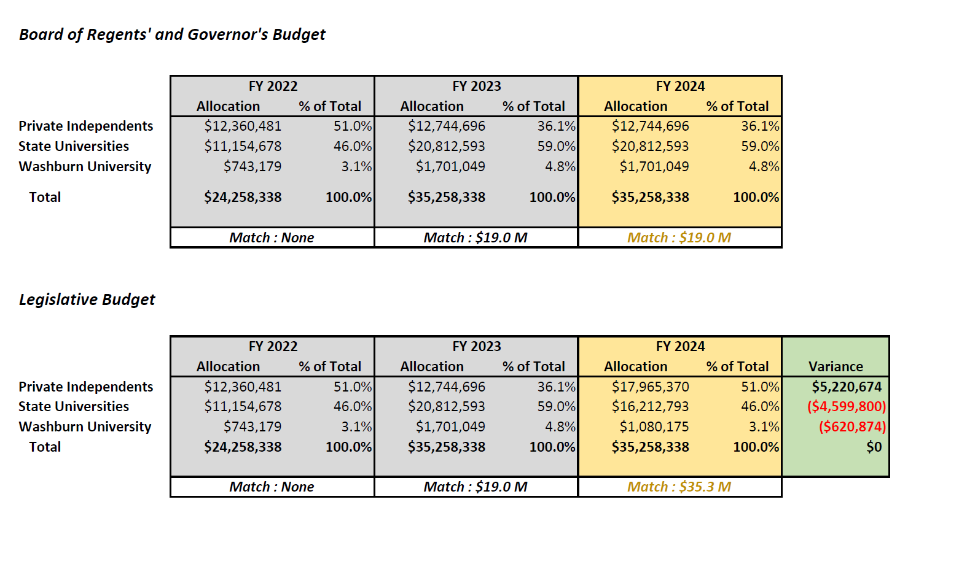

Slide 15
Questions?
lnicholson@ksbor.org
785-430-5464

