Slide 1
Kansas Promise Scholarship Update
Leah Nicholson, Director of Student Financial Assistance

Slide 2
Application Process
Student applies through KBOR Online Application – will require student to create a login with KBOR

Slide 3
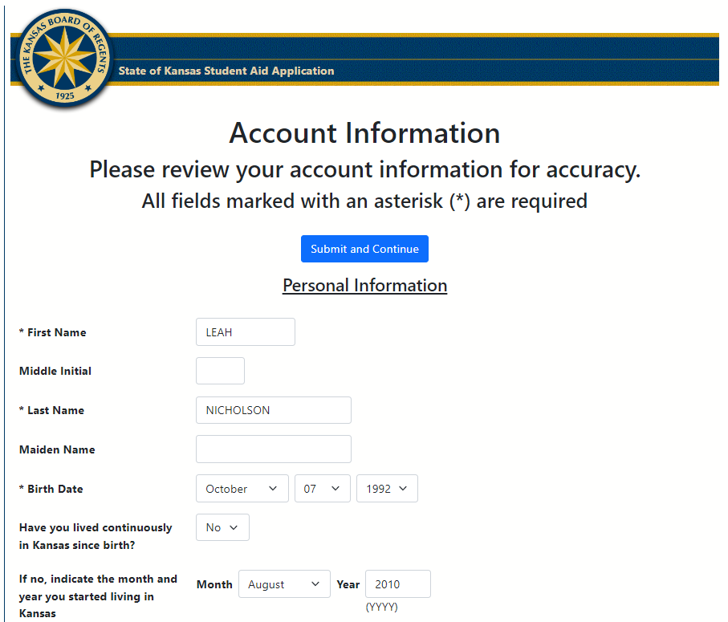
Student Application: sfa.kansasregents.org

Slide 4
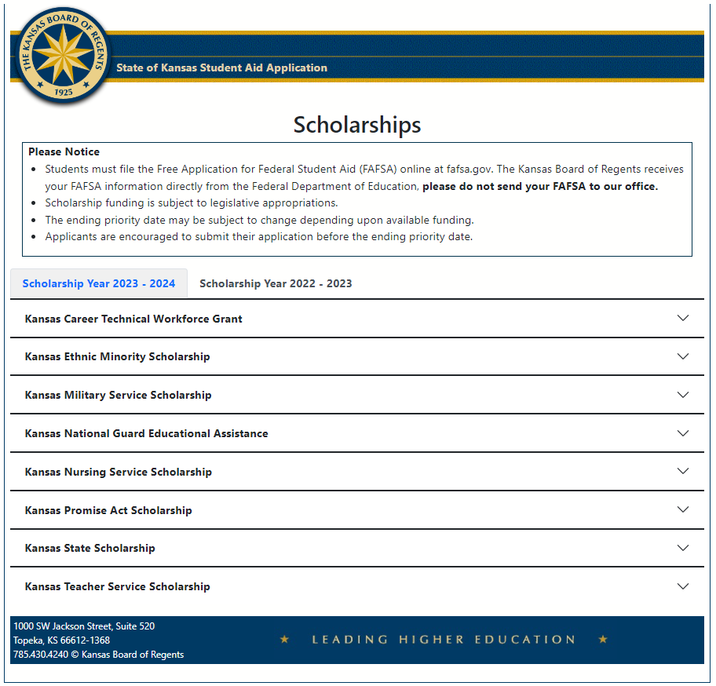
Student Application
Students can currently choose from two scholarship years; the newest scholarship year shows first. They can click on the 2022-2023 tab to see applications open for that year.

Slide 5
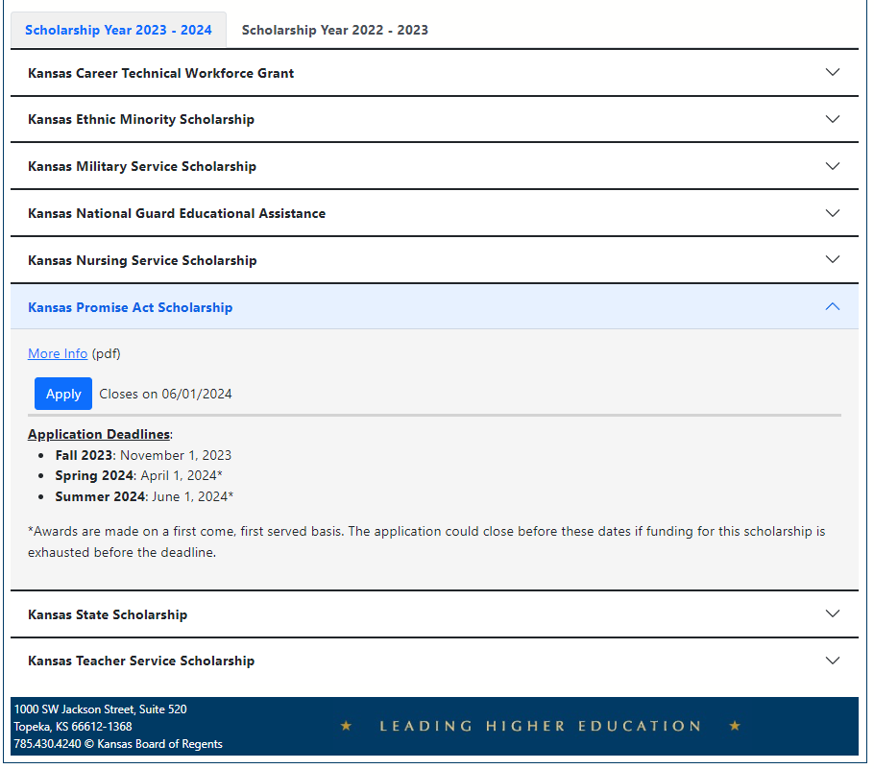
Student Application
Students can currently choose from two scholarship years; the newest scholarship year shows first. They can click on the 2022-2023 tab to see applications open for that year.

Slide 6
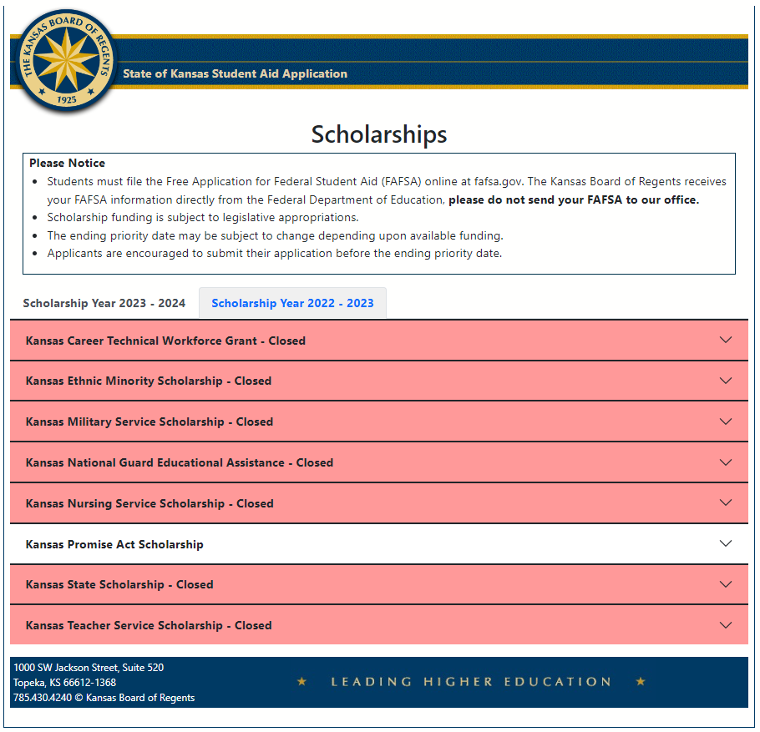
Student Application
Students can currently choose from two scholarship years; the newest scholarship year shows first. They can click on the 2022-2023 tab to see applications open for that year.

Slide 7
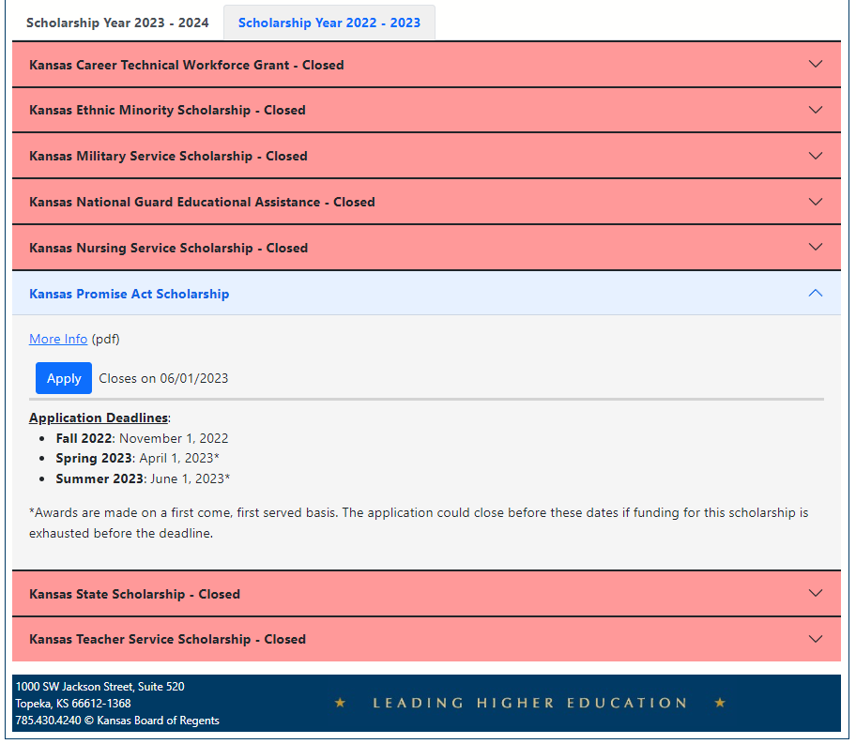
Student Application
Students can currently choose from two scholarship years; the newest scholarship year shows first. They can click on the 2022-2023 tab to see applications open for that year.

Slide 8
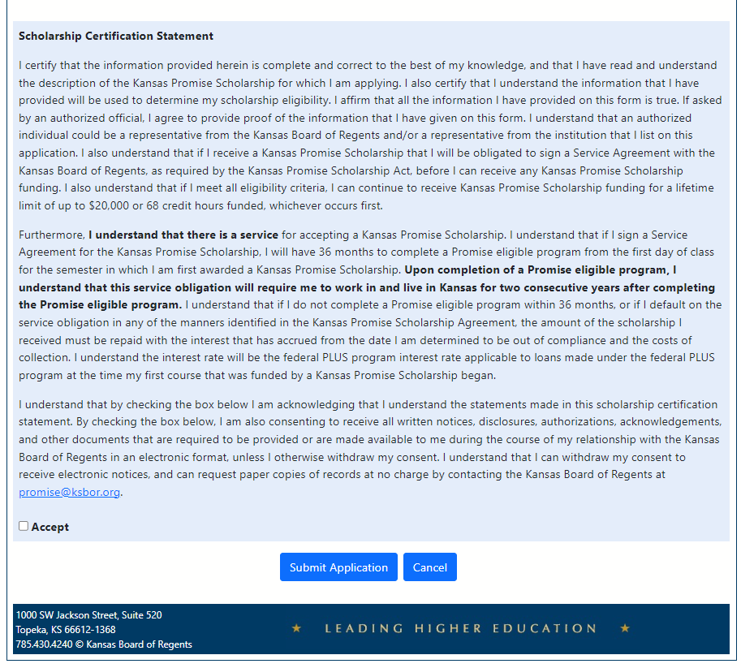
Student Application

Slide 9
After a new student applies:
Students receives an automated email
We remind them to file a FAFSA
And that their school might ask for residency documents
We inform them that the application will be reviewed by their school and, if eligible, they will be reached out to by their school and then KBOR if they need to sign a promissory note.
We tell them to contact the school for questions about eligibility, award amounts and timelines for review. They can contact KBOR for any other questions.

Slide 10
Application Process
Student applies through KBOR Online Application – will require student to create a login
Application is checked for limits; application will then be routed to institution to review eligibility
Eligible application will then be reviewed by institution to calculate a Pre-Award; institution counsels student on award and obligations

Slide 11
Institutions should:
Review applications to confirm eligibility and calculate pre-award amounts
Communicate application decisions to students and counsel students on award offers and service obligations
Review students for SAP (Award Certification or Eligibility)

Slide 12
Example Statement for School
If you have already signed a Promise Act service agreement promissory note with the Kansas Board of Regents, then there are no further steps you will need to take to receive your Promise Act award.
If you do not already have a signed Promise Act service agreement on file with the Kansas Board of Regents, the Kansas Board of Regents will reach out within the next 1-2 business days to request that you sign a service agreement promissory note for the Kansas Promise Act Scholarship. This service agreement acts as a contract between you and the state of Kansas. This service agreement will outline the requirements you must meet to remain eligible for the Promise scholarship, as well as the service obligations you must complete to avoid having to repay your scholarship back to the State of Kansas. The service obligation requires that you work and live in the State of Kansas for two consecutive years following the successful completion of your Promise-eligible program of study.
The Kansas Board of Regents will contact you within the next 1-2 business days by email from scholars@ksbor.org with instructions on how to review and sign your service agreement promissory note. You will not be able to receive your Promise scholarship until the Kansas Board of Regents has your signed service agreement on file.

Slide 13
Application Process
Student applies through KBOR Online Application – will require student to create a login
Application is checked for limits; application will then be routed to institution to review eligibility
Eligible application will then be reviewed by institution to calculate a Pre-Award; institution counsels student on award and obligations
Application will then be routed to KBOR to request a promissory note from student
Student will navigate promissory note process through ECSI – will require ECSI PIN information
If promissory note is signed, application is routed back to institution to officially award the student
Renewal Students
Nightly Process
Nightly Process
Nightly Process

Slide 14
Renewal students: Automatic Renewal
Receive an automated email informing them their scholarship is renewed.
If they don’t plan to continue enrollment, they can disregard the email.
If they plan to continue enrollment but don’t want further funding: contact your school.
We provide a link to where they can review and update their application.
If they make an update, they get an automated email informing them they made an update.
We remind them to submit a FAFSA, to update their contact info with KBOR, and that they previously agreed to a service obligation.
We tell students to contact their school if they have questions about review timelines or award amounts, or if they want to decline further awards.

Slide 15
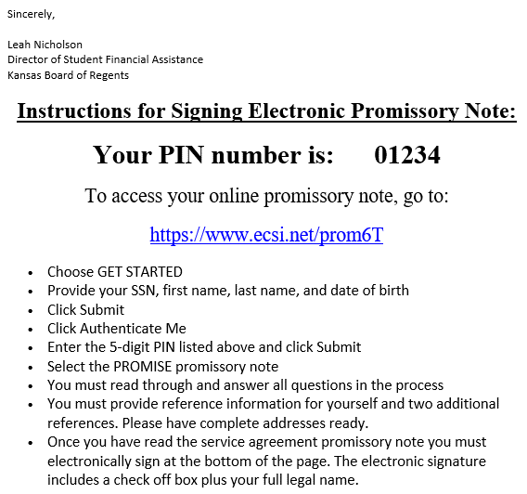
Promissory Note Email

Slide 16
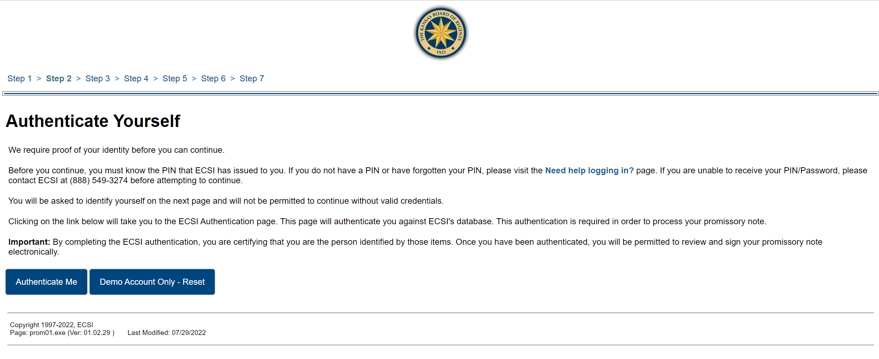
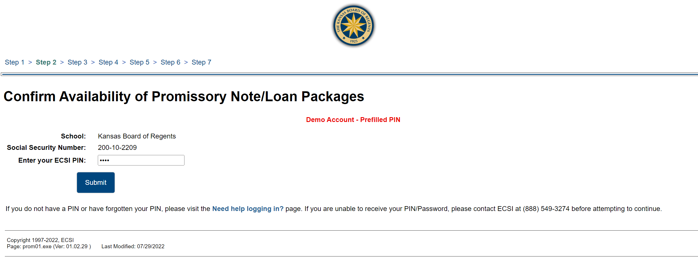
Promissory Note Process

Slide 17
Promissory Note Process

Slide 18
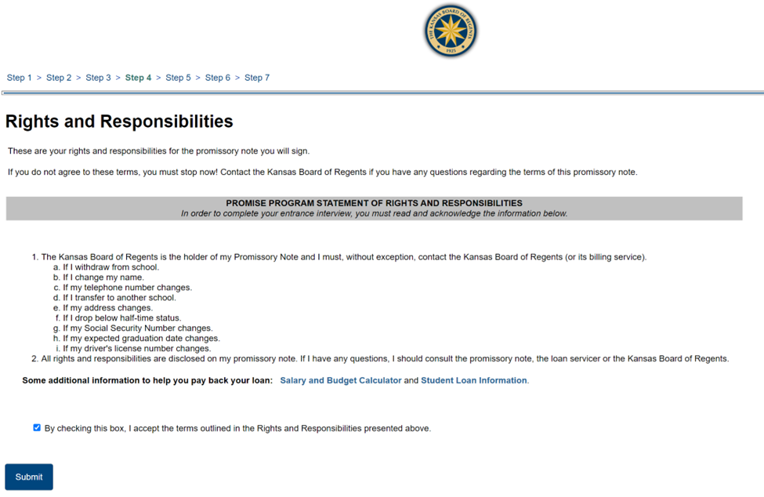
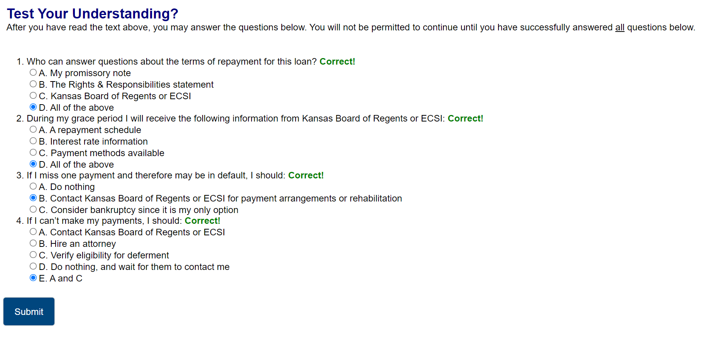
Promissory Note Process

Slide 19
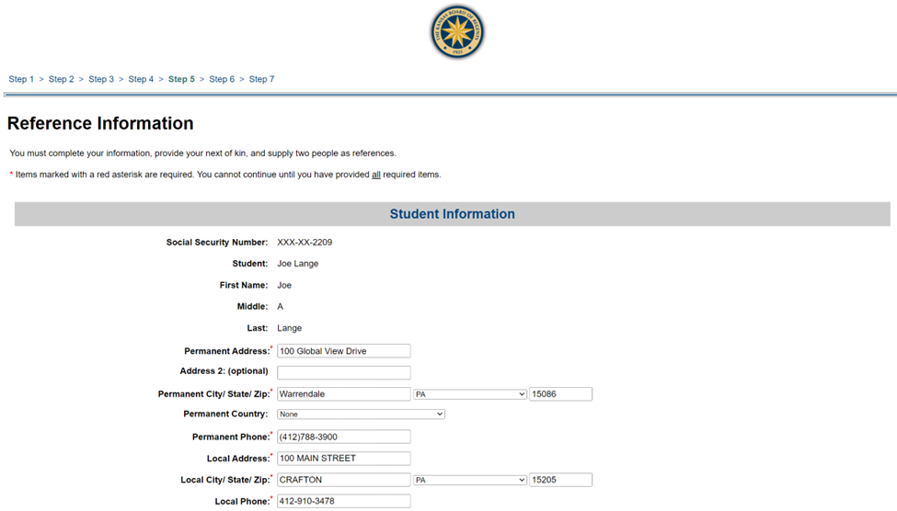
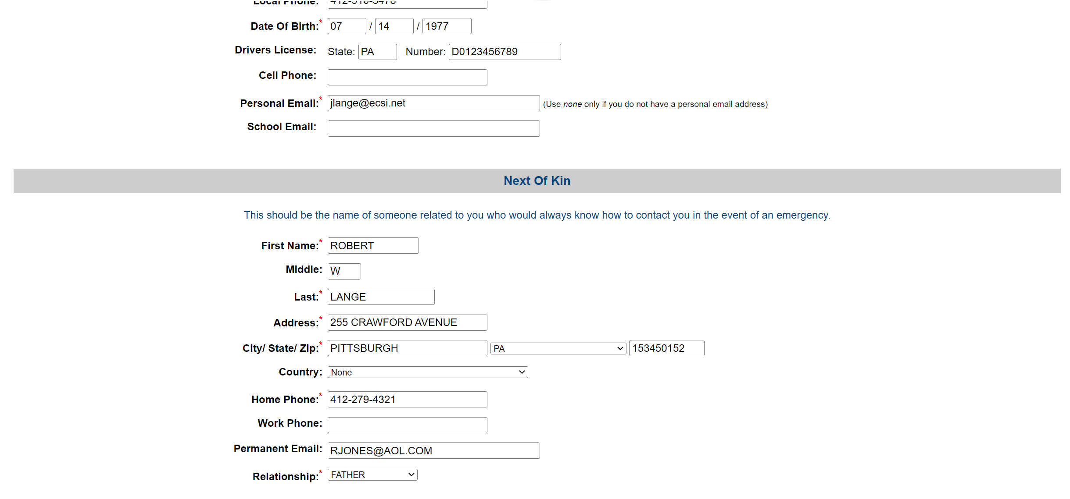
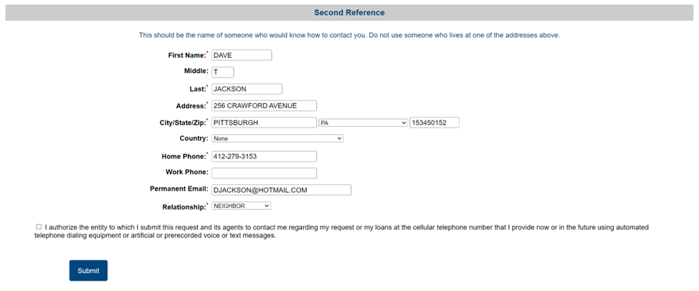
Promissory Note Process

Slide 20
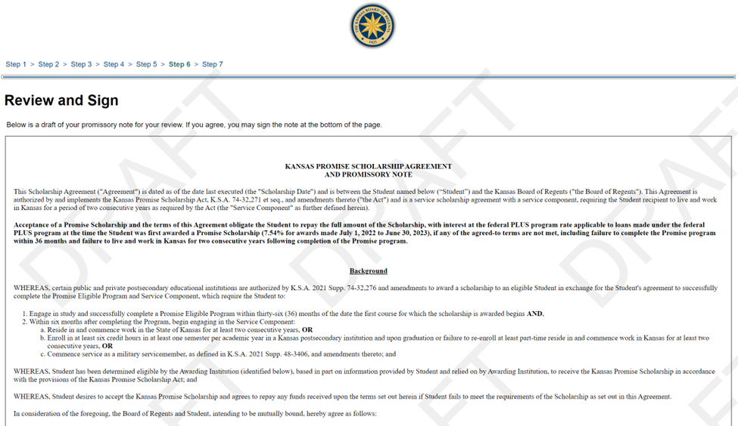
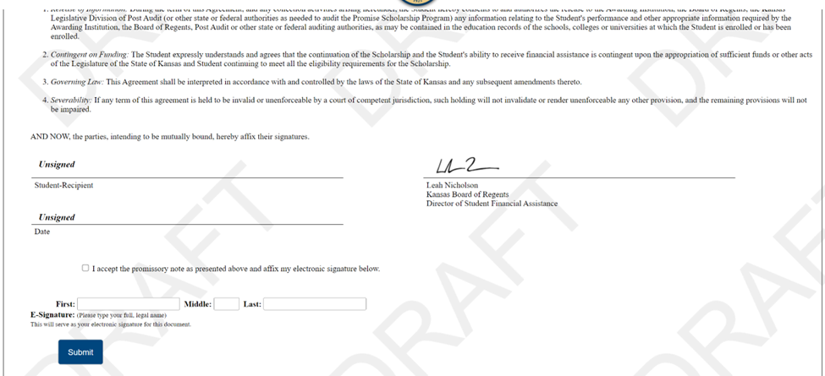
Promissory Note Process

Slide 21
Promissory Notes
If students cannot find their promissory note email, they can contact scholars@ksbor.org to request a new one be sent.
Award amount listed in the promissory note is based on all pre-award information reported at the time the promissory note email was sent to the student. If the amount has changed, we will update the award amount with certified award information at the end of each certification period.
Updating signatures is a manual process, resulting in a 1-2 day delay.

Slide 22
Application Process
Student applies through KBOR Online Application – will require student to create a login
Application is checked for limits; application will then be routed to institution to review eligibility
Eligible application will then be reviewed by institution to calculate a Pre-Award; institution counsels student on award and obligations
Application will then be routed to KBOR to request a promissory note from student
Student will navigate promissory note process through ECSI – will require ECSI PIN information
If promissory note is signed, application is routed back to institution to officially award the student
Institutions will certify the award amount each semester – this is where any award adjustments can be made
Nightly Process
Renewal
Students
Nightly Process
Nightly Process

Slide 23
Award Certification
Students will show up on your Award Certification screen 1-3 days after they have signed and submitted their promissory note.
Institutions should:
Review students for adjustments and actual disbursed awards (Award Certification)
Review students for SAP (Award Certification or Eligibility)

Slide 24
Application Process
Student applies through KBOR Online Application – will require student to create a login
Application is checked for limits; application will then be routed to institution to review eligibility
Eligible application will then be reviewed by institution to calculate a Pre-Award; institution counsels student on award and obligations
Application will then be routed to KBOR to request a promissory note from student
Student will navigate promissory note process through ECSI – will require ECSI PIN information
If promissory note is signed, application is routed back to institution to officially award the student
Institutions will certify the award amount each semester – this is where any award adjustments can be made
KBOR will send quarterly payments
Nightly Process
Renewal
Students
Nightly Process
Nightly Process

Slide 25
Promise Act Payments
All payments will be based on certified award amounts. This means that the certify check box has a check mark indicating your school confirms that the amount reported on the award certification screen is what the student actually received.
Payments will be made in lump sum to schools. If you download a list after you certify awards, you can cross reference your award certification list to determine awards paid, if needed.

Slide 26
Promise Act Payments
Mar. 15, 2023: KBOR sent remaining fall awards, and any certified spring awards; summer certification opened
June 1, 2023: Spring certification closes; KBOR will pull certified award amounts for spring and summer
June 15, 2023: KBOR will send remaining spring awards, and any certified summer awards
Sept. 1, 2023: Summer certification closes; KBOR will collect certified award amounts for summer
Sept. 15, 2023: KBOR will send remaining 2022-2023 payment to schools and will reconcile overpayments after
Dec. 1, 2023: KBOR will pull certified award amounts for fall 2023
Dec. 15, 2023: KBOR will send another payment to schools; spring 2024 certification opens
Mar. 1, 2024: Fall certification closes; KBOR will pull certified award amounts for fall 2023 and spring 2024
Mar. 15, 2024: KBOR will send another payment to schools; summer certification opens
June 1, 2024: Spring certification closes; KBOR will pull certified award amounts for spring 2024 and summer 2024
June 15, 2024: KBOR will send another payment to schools
Sept. 1, 2024: Summer certification closes; KBOR will collect certified award amounts for summer 2024
Sept. 15, 2024: KBOR will send final 2023-2024 payment to schools

Slide 27
Application Process
Nightly Process
Student applies through KBOR Online Application – will require student to create a login
Application is checked for limits; application will then be routed to institution to review eligibility
Eligible application will then be reviewed by institution to calculate a Pre-Award; institution counsels student on award and obligations
Application will then be routed to KBOR to request a promissory note from student
Student will navigate promissory note process through ECSI – will require ECSI PIN information
If promissory note is signed, application is routed back to institution to officially award the student
Institutions will certify the award amount each semester – this is where any award adjustments can be made
Institutions will report when student completes their promise program
KBOR will send quarterly payments
Renewal
Students
Nightly Process
Nightly Process

Slide 28
Program Completion
You can do this once per semester, as long as we receive information by the requested date.
The program(s) we have on record for the student will be listed on the screen; you can other promise programs if the student completed a different one.
This information will be used to determine which students KBOR needs to reach out to, and which students will eventually be put into repayement.

Slide 29
Application Process
Nightly Process
Student applies through KBOR Online Application – will require student to create a login
Application is checked for limits; application will then be routed to institution to review eligibility
Eligible application will then be reviewed by institution to calculate a Pre-Award; institution counsels student on award and obligations
Application will then be routed to KBOR to request a promissory note from student
Student will navigate promissory note process through ECSI – will require ECSI PIN information
If promissory note is signed, application is routed back to institution to officially award the student
Institutions will certify the award amount each semester – this is where any award adjustments can be made
Institutions will report when student completes their promise program
KBOR will send quarterly payments
KBOR will communicate with student on work verification process /repayment process
Renewal
Students
Nightly Process
Nightly Process

Slide 30
Status Verification
Students must complete a Promise program within 36-months of their first award
Within six months of completion, they must then work AND live in Kansas for two consecutive years (24 months - full-time or part-time work)
They can postpone for specific reasons
If they do not meet the above, they will be placed into repayement

Slide 31
Status Verification
About a month after you report completion, we will reach out to students to communicate the status verification process.
We will request they submit their status verification within the 6-month period
We will request status verification at the beginning, midway, and end of the two-year requirement.
Students will have to have 24 months of work verified; will have to continue obligation until the 24 months are met.
Let’s look at the form together…

Slide 32
Questions?
Email promise@ksbor.org
Navigate the Kansas Regents’ website to for Promise information:
Kansasregents.org > Students > Financial Aid > Promise Act Scholarship

