Slide 1

CFPB Debt Collection Rules Panel
Kelli Lowe – Credit World Services, Inc.
Scott Medley – Reliant Capital Solutions, Llc
J.R. Berninzoni – Williams & Fudge, Inc.
April 8, 2021

Slide 2



Agenda
How Did We Get Here?
New CFPB Rules
Committed Partner
The new CFPB Rules have been on the table and after many years of comments submitted from various vested organizations, the final rule was announced on October 30, 2020.
Compliance has always played an important role in collections and even more so now.
Agencies must be proactive and create a strategy that may include digital channels and continuously monitor for compliance.
Managing consent is will be more crucial than ever.
Schools will need to incorporate the elements of the final rules into their oversight of debt collectors
Schools should be prepared to work with your agency partners to ensure compliance for both the agency and your school.
2

Slide 3
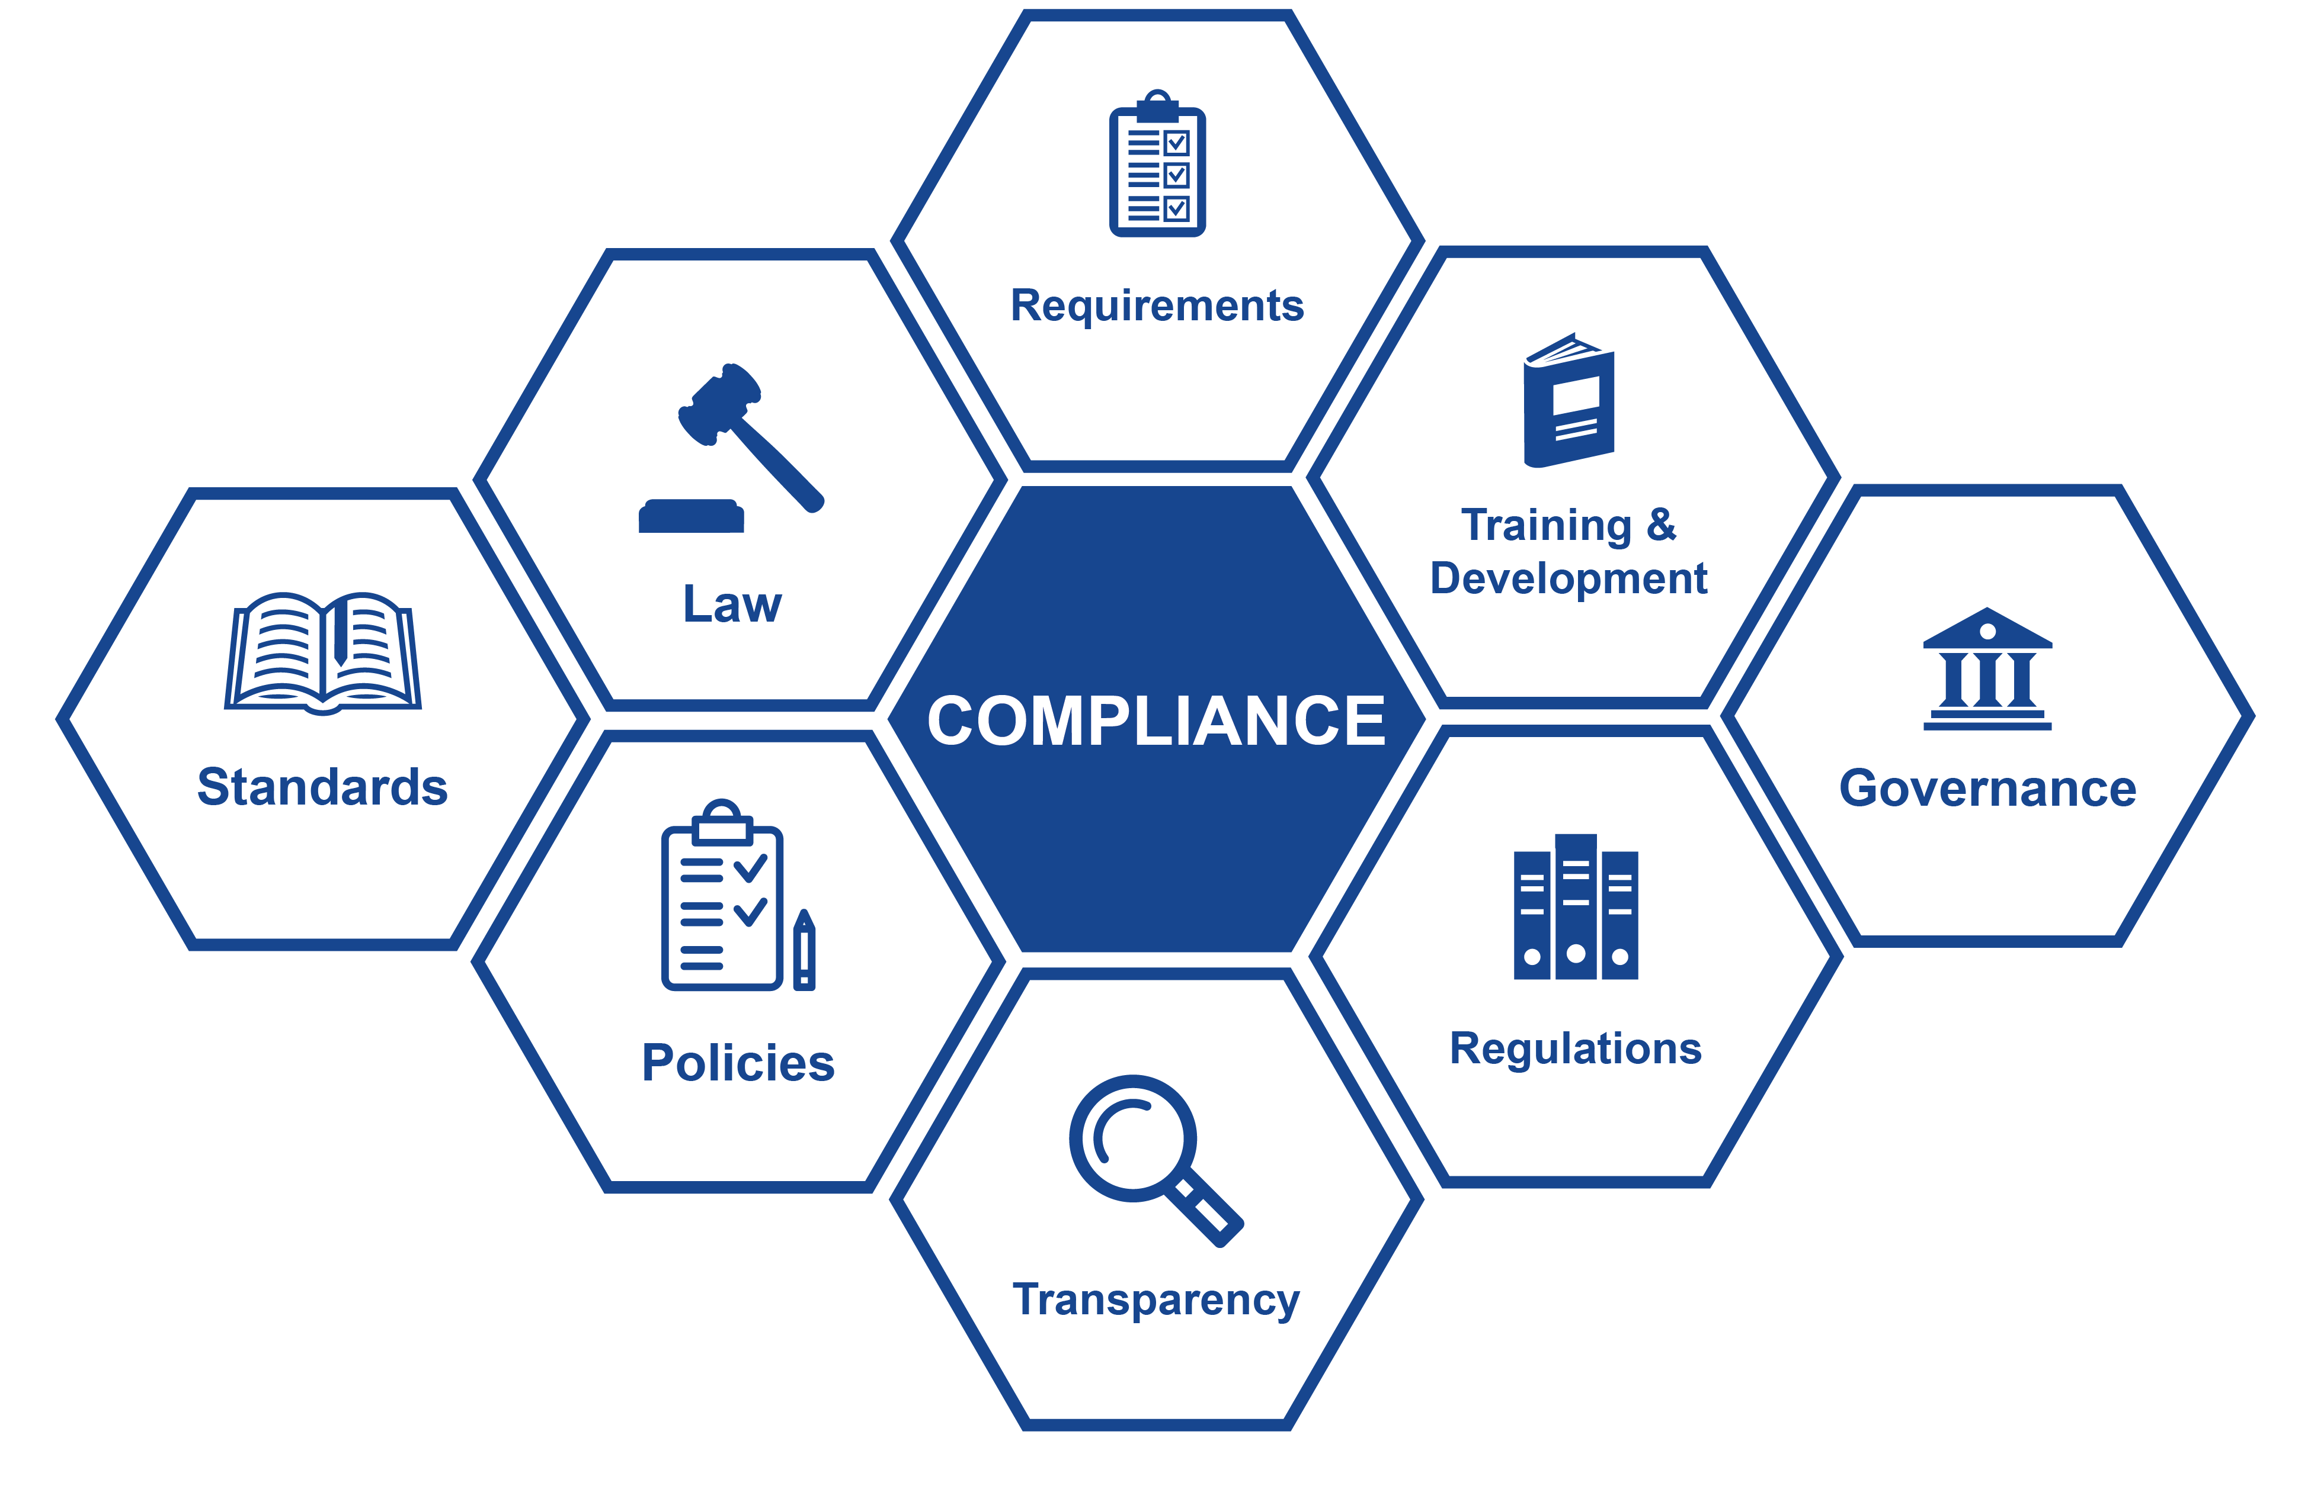
How Did We Get Here?

Slide 4
How Did We Get Here
There have been a variety of consumer debt laws at both the federal and state levels that regulate consumer affairs, most that you might be familiar with:
  FDCPA
  FCRA
  Truth in Lending Act
  Gramm-Leach- Bliley Act
  FTC, Red Flags Rule
  UDAAP
  CFPB

Slide 5
FDCPA
1978 FDCPA (Fair Debt Collection Practices Act) was designed to eliminate abusive, deceptive, and unfair debt collection practices. This was an amendment to the Consumer Credit Protection Act, which allows for legal protection against debt collection abuse.
  Publish debtor’s names, along with debt information
  Use bad language when making contact
  Call repeatedly
  Make false statements or represent themselves as other individuals such attorneys or police
  Misrepresent the amount owed
  Restricts times the collector can call (inconvenient place and time)
  Try to collect extra fees

Slide 6
CFPB
In 2010, the Dodd-Frank Act revised the FDCPA and created the Consumer Financial Protection Bureau to protect consumers from unfair, deceptive, or abusive acts or practices by financial service providers, including debt collectors.
  2013 CFPB issued Advance Notice of Proposed Rulemaking to collect information from the credit and collection industry.
  2016 CFPB created a panel under Small Business Regulatory Enforcement Fairness Act to obtain feedback on its outline of debt collection proposals under consideration.
  October 2020 issued a final rule amending Regulation F
  December 2020 issued a final rule addressing and clarifying out of stat disclosures, validation notice, credit reporting
  Final Rule is scheduled to go into effect November 30,2021.
New Rules: 12 C.F.R. 1006 (Regulation F)
  The Debt Collection Rule implements federal law and does not interpret state law. The Debt Collection Rule does not affect a person’s responsibility to comply with state laws that are consistent with or provide greater protection to consumers than the FDCPA or the rule.

Slide 7
Key Takeaways….
Applies to 3rd party
Telephone call frequencies
Validation notice template/ safe harbor
Clarification and safe harbor in regard to emailing, texting consumers provided that the final rules procedural framework is followed.
  Communications must include simple instructions for opt out – Follows E-sign act, consumer confirms consent
Handshake letter – from creditor to consumer to pass on email address to agency
Limited content message
Credit reporting

Slide 8
New CFPB Debt Collection Rules

Slide 9
Time & Place
Clarifies the times and places, when and where a debt collector may communicate with a consumer
  Inconvenient Times
    8am – 9pm
    Must be cognizant of area codes (both land and cell) and mailing address
  Can communicate at work using personal email or cell number if provided by creditor that was used in the first place to communicate; not a violation of absent of knowledge.
  Confirmed guidelines in communicating with a consumer that is represented by an attorney.

Slide 10
Channel & Frequency Restrictions
Restricts the channel a to communicate with a consumer.
Imposes limits on the number of calls that can be made.
  Seven (7) attempts in a seven (7) day period
    Exception of consent for call back
    Includes ringless messages
    Limit is per account not consumer
    Texting and calls only
    Doesn’t include emails (no limit)

Slide 11
Email & SMS
Permits the use of email and text messages, with limitations and requirements
  Explicit opt-out messages
  Must obtain consent
Validating Contacts - May require school to provide specific disclosures for this to be used (safe harboring)
  Notify the student that the debt collector will use a non-work email and send texts to a non-work phone. Email addresses are only transferable (in terms of consent) to the debt collector if they are on a domain that is available to the general public.
  May require schools to run these notice-and-opt-out campaigns to scrub email addresses
  Must include name of agency and provide opt-out with a reasonable time to do so (35 days minimum)

Slide 12
Limited Consent Messages & Recordings
Better describes what a limited-consent message needs to look like (voice messages)
  A business name (cannot not reveal it is a collection agency)
  Reply request
  Name or names of one or more persons who can be contacted
  Telephone number or numbers
  Must retain evidence of compliance starting on the date that the collector begins collection activity
3 Years Retention Period
  The collectors last communication or attempted communication
  The debt is settled, discharged, or transferred back to the creditor or to another debt collector

Slide 13
Committed Partnership

Slide 14
1st Party Implications vs. 3rd Party Impact
Why should YOU care? You’re a 1st party, you’re not even a 3rd-party debt collector?
  1st Party Culpability
  Creditors must engage with their Agency partners
  The “New Due Diligence”

Slide 15
Final Rule Comments
The CFPB oversees FDCPA (Fair Debt and Collection Practice Act), as well as UDAAP (Unfair, Deceptive or Abusive Acts or Practices). UDAAP applies to original creditor, the school, as well as to the agencies, while the FDCPA applies to only your agencies … however, schools are responsible for what your agencies do or don’t do.
The CFPB (Consumer Financial Protection Bureau) released on October 30, 2020, New Rules to be implemented on 11-30-21 to give 3rd parties (your collection agencies) and you an opportunity to put things in place, so as to comply.

Slide 16
CFPB Final Rule (Regulation F)
PROHIBITION AGAINST PASSIVE DEBT COLLECTION, SOMETIMES CALLED "DEBT PARKING"
  The Disclosure Focused Rule requires debt collectors to communicate with a consumer “about a debt” before furnishing information about a debt to a consumer reporting agency ("CRA"). This practice is often called “debt parking.”
  Part Two of the Rule requires a debt collector to inform the consumer (either by phone or in writing, (including Electronic Communication*) “about a debt,” which could be in the prescribed initial collection notice and wait a reasonable time (14 days) before the debt collector can furnish data to the CRAs. The debt collector must monitor whether the initial communication “about a debt” is undelivered before furnishing data to the CRAs.
  Can use the initial collection notice to communicate with the consumer “about the debt”.
  * Agencies still need consent to communicate electronically with consumers.

Slide 17
Data Furnisher Rules
Initiative
Report the name of the Original Creditor and Creditor Classification Code
Do not report debt that did not arise from a contract or agreement to pay
Report a full file monthly
Furnisher Action
Report the Original Creditor Name and the valid Creditor Classification Code according to the Metro 2® format. These fields are required for each account or item reported.
Do not report debt that did not arise from a contract or agreement to pay, including, but not limited to, certain fines, tickets, and other assessments. For example, library fees or fines, parking tickets, speeding tickets, and court fees or fines.
To avoid potential deletion of data by the CRAs, you must report your full file monthly including accounts that are open, that are paid in the last 90 days, or that require deletion or correction.

Slide 18
Data Furnisher Rules
Initiative
Do not report Medical Debt collection accounts less than 180 days old
Remove Debt paid or being paid by insurance
Reporting of consumer personally identifiable information
Furnisher Action
A new minimum standard has been established to expand the CRAs’ capabilities to match credit data to the file of the appropriate consumer.
Furnishers of newly opened trade and collection data must report the full name (First, Middle, Last Name and Generation Code/Suffix), address, full Social Security Number and Date of Birth (mmddyyyy).
If full Social Security Number is not available, full Date of Birth (mmddyyyy) will be required.
This new minimum standard will apply to accounts reported with a Date Opened after the Effective Date in order for the CRAs to accept these records for processing.
Data will be monitored to ensure these requirements are met.

Slide 19
§1006.34(c): Validation Information
A debt collector must provide the following validation information
  Information about the debt. Except as provided in paragraph (c)(5) of this section:
  The debt collector’s name and the mailing address at which the debt collector accepts disputes and requests for original-creditor information.
  The consumer’s name and mailing address.
  If the debt collector is collecting a debt related to a consumer financial product or service as defined in § 1006.2(f), the name of the creditor to whom the debt was owed on the itemization date.
  The account number, if any, associated with the debt on the itemization date, or a truncated version of that number.
  The name of the creditor to whom the debt currently is owed.
  The itemization date.
  The amount of the debt on the itemization date.
  An itemization of the current amount of the debt reflecting interest, fees, payments, and credits since the itemization date. A debt collector may disclose the itemization on a separate page provided in the same communication with a validation notice, if the debt collector includes on the validation notice, where the itemization would have appeared, a statement referring to that separate page.
  The current amount of the debt.

Slide 20
Itemization
Itemization date means any one of the following reference dates for which a debt collector can ascertain the amount of the debt.
  The last statement date, which is the date of the last periodic statement or written account statement or invoice provided to the consumer by a creditor;
  The charge-off date, which is the date the debt was charged off;
  The last payment date, which is the date the last payment was applied to the debt;
  The transaction date, which is the date of the transaction that gave rise to the debt; or
  The judgment date, which is the date of a final court judgment that determines the amount of the debt owed by the consumer.
  If the debt collector is collecting a debt related to a consumer financial product or service as defined in § 1006.2(f), the name of the creditor to whom the debt was owed on the itemization date.
  The amount of the debt on the itemization date.
  An itemization of the current amount of the debt reflecting interest, fees, payments, and credits since the itemization date.

Slide 21

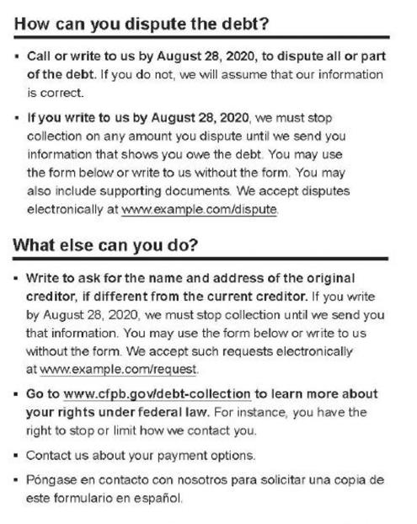
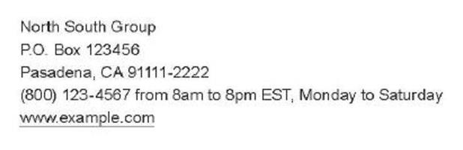


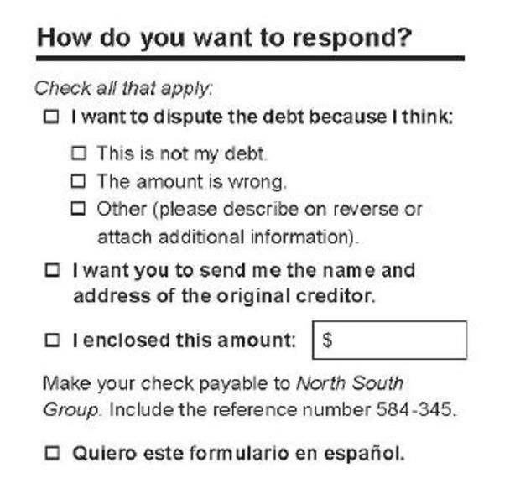
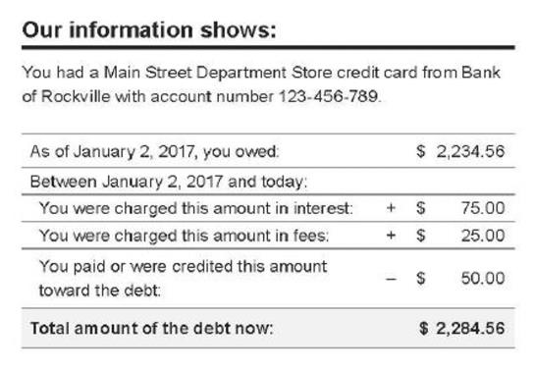
Validation Notice: Form Model

Slide 22
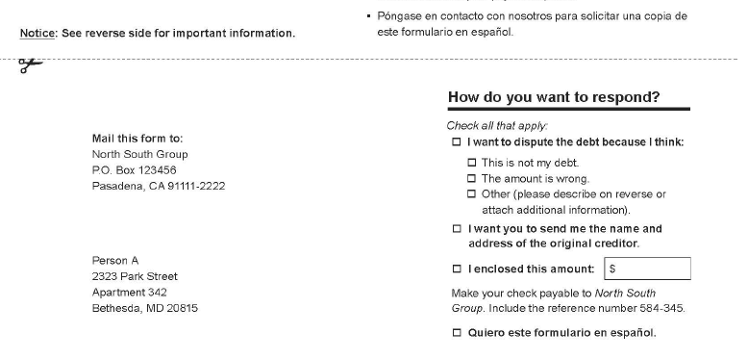

Validation Noticed: Form Model
Bottom portion of form
Reverse side contains any state-specific items, when required, that do not fit on the front of the notice.

Slide 23
1st Party Impact
Schools will need to incorporate the elements of the final rules into their oversight of debt collectors which includes Credit Bureau Reporting and Debt Validation.
  Ensure contact attempts are made at “convenient times”; e.g. agencies need to consider consumer’s time zone
  Monitor call frequency
  Monitor proper disclosures are performed (Mini-Miranda)
  Monitor for potential harassment contact attempts via all communication channels
  Schools should be prepared to work with your agency partners to ensure compliance for both the agency and your school

Slide 24

Committed Partnership
As in all aspects of the School/Agency partnership, collection agencies desire accurate, clear and timely communication and information from their school partners.
Collection agency data is only as good and as compliant as the data received from our clients.

Slide 25
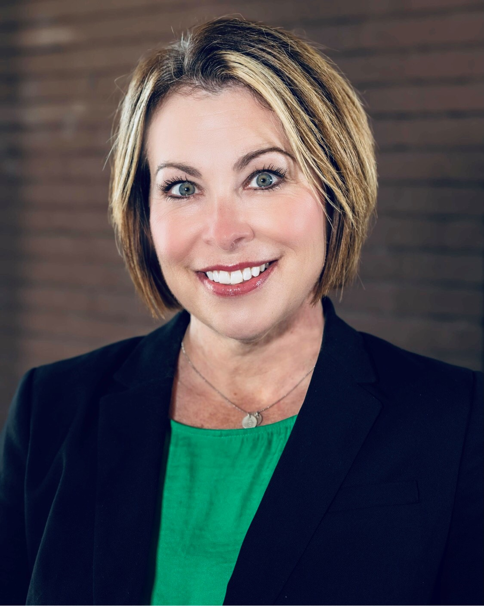





Questions
Kelli Lowe
Scott Medley
J.R. Berninzoni
Director of Operations
913-362-3950 x2100
kellilowe@creditworldservices.com
www.creditworldservices.com
Executive Vice President of Sales
614-674-0543
smedley@reliant-cap.com
www.reliantcapitalsolutions.com
Associate Vice President of Sales
803-322-3081
berninzo@wfcorp.com
www.wfcorp.com
25

