Slide 1


2026-27 FAFSA Info

Slide 2

Agenda
Introduction
Studentaid.gov Account (FSA ID) Set Up Process
Filling out the 2026-27 FAFSA
After the FAFSA is submitted
Virtual FAFSA Help

Slide 3
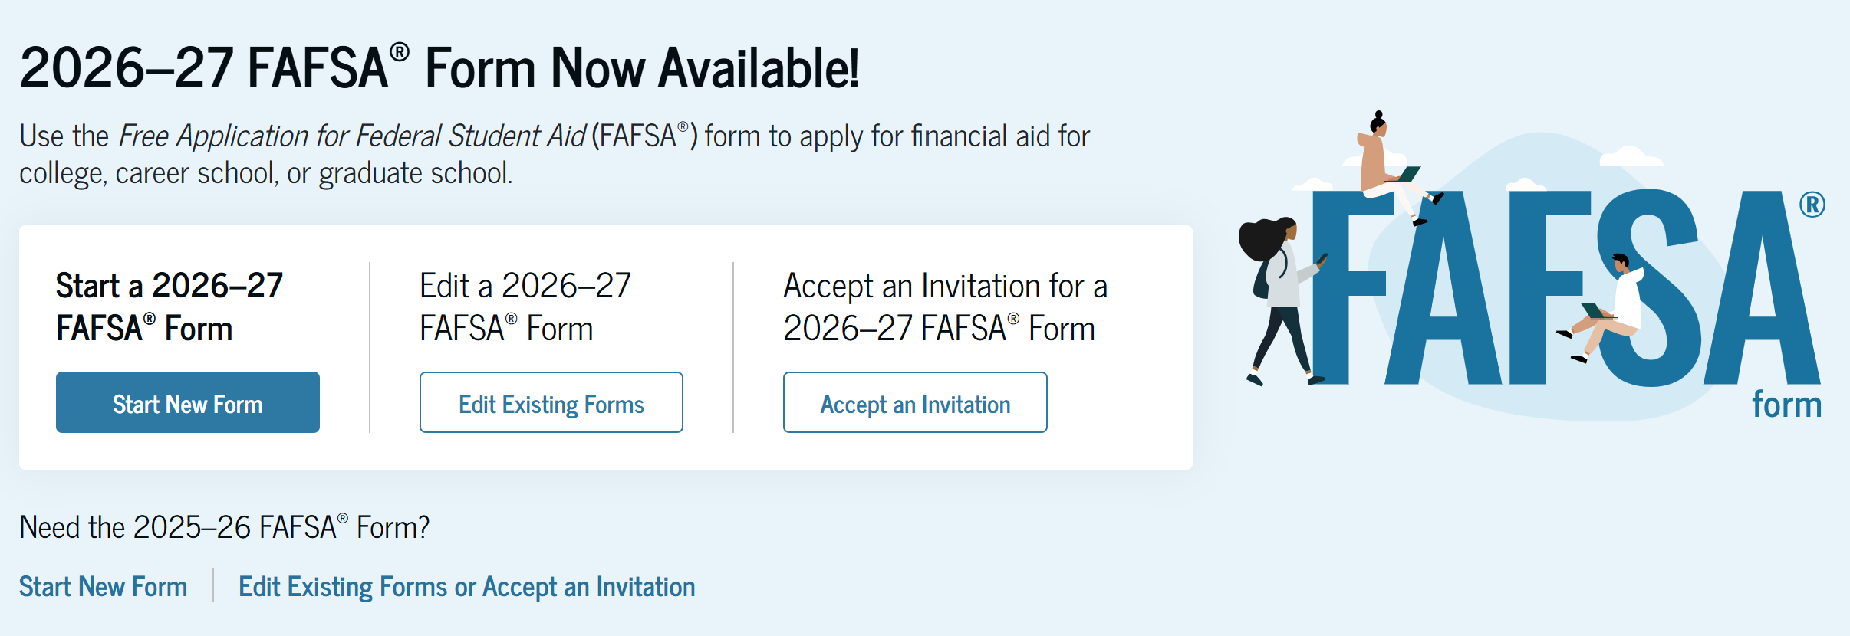
FAFSA
Free Application for Federal Student Aid
Studentaid.gov
2026-2027 FAFSA:
2024 tax information
File every year
Priority Dates
Available beginning October 1st

Slide 4
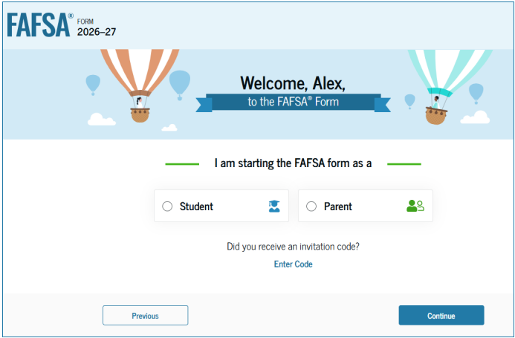
Role-Based Form
After logging in, you will be asked to select the applicable role to fill out your section of the FAFSA.
You will be given “onboarding” on how to navigate the form based on the role you select.

Slide 5
IRS Direct Data Exchange
The FA-DDX is the secure system that lets the IRS share your Federal Tax Information (FTI) with your FAFSA.
For each contributor who consents, it imports:
Tax filing status
Adjusted Gross Income (AGI)
Income earned from work
U.S. income tax paid
Education tax credits
Tax-exempt interest income
Untaxed IRA distributions
Untaxed pension & annuity distributions
IRA deductions & payments to retirement plans
Business or farm income (if applicable)
Schedules filed (A, B, C, D, E, F, or H)
Number of dependents claimed on the tax return
FTI = Federal Tax Information
It’s the tax data the IRS sends to your FAFSA.
It helps fill in your financial questions automatically, so you don’t have to type everything in.
It includes things like your income, tax filing status, tax paid, and certain untaxed income.
You (and your contributor, if applicable) must give consent for FAFSA to use this info.
Without consent, your FAFSA can’t be processed or receive aid.

Slide 6
IRS Direct Data Exchange
Below are some scenarios when FA-DDX Cannot Be Used:
❌ No 2024 federal tax return filed
❌ Filed an amended tax return (Form 1040-X)
❌ Used a foreign tax return instead of a U.S. return
❌ Filed a Puerto Rican or other U.S. territory tax return
❌ Marital status changed (now married now but filed as single, etc.)
❌ Identity verification issues with the IRS
❌ Tax return not yet processed by the IRS
❌ Filed a nontraditional return (e.g., 1040-NR, 1040-SS)
❌ Contributor refuses consent to transfer IRS data
If this is the case:
You will need to manually enter your financial information on the FAFSA
You may need to verify your information by providing income/tax documents to your school. The school will notify you if this is the case.

Slide 7
STUDENTAID.GOV ACCOUNTS

Slide 8
Account Creation
Each person creates their own account.
Type your name exactly as it appears on your Social Security Card
Link your email address (required) and phone number (optional).
Use an email address/phone number you will have access to after graduation.
Each account must have a unique email address/phone number.
Will need to verify each through the set-up process
Remember your Username and Password, and challenge questions, you will need them each year.

Slide 9
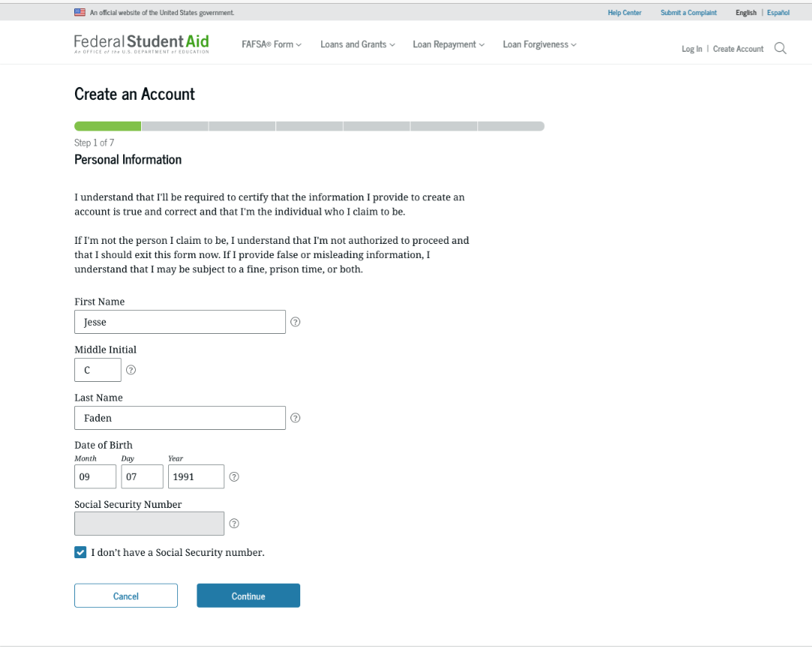
Account Creation Cont.
https://studentaid.gov/fsa-id/create-account/launch
Account will require a verifiable email address
Account must be created AND verified through Social Security Administration before the FAFSA can be completed

Slide 10
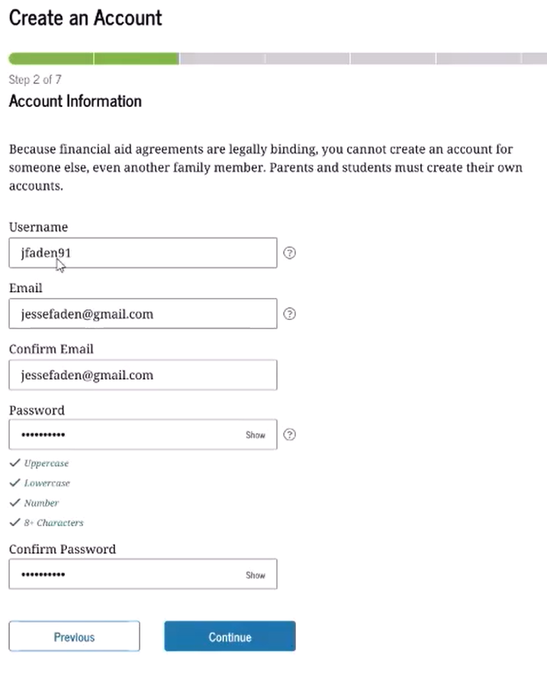
Account Creation Cont.
Steps
Enter Name, Date of Birth and SSN
  If you don’t have a SSN, check the box
Create your Username
Enter and confirm your email
Create and confirm your password

Slide 11
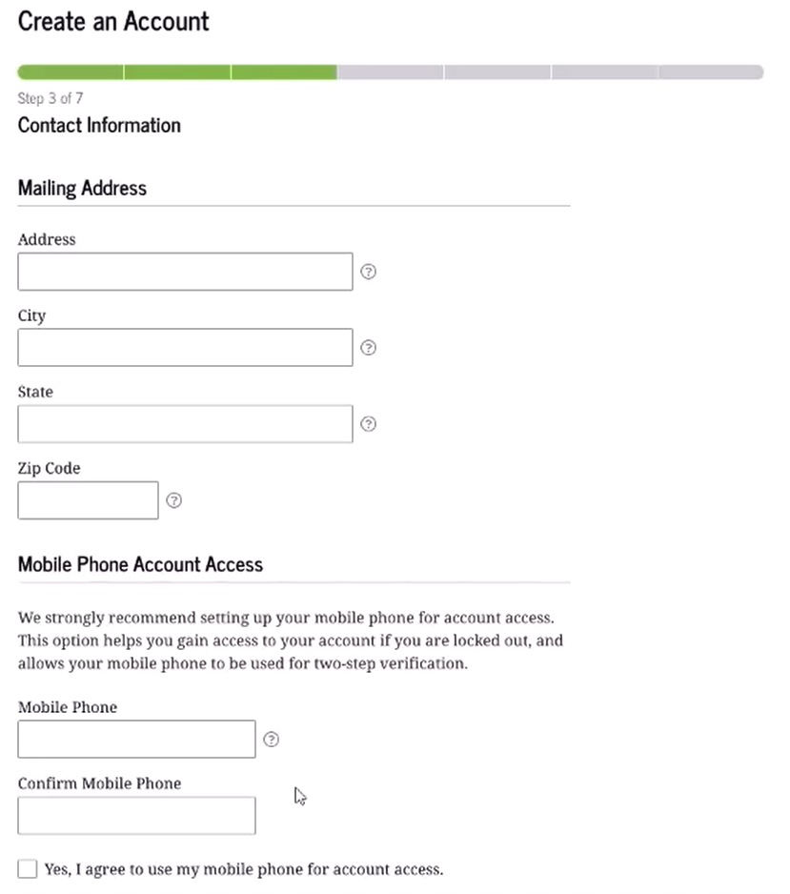
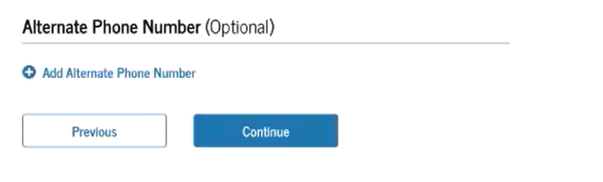
Account Creation Cont.
Steps
Enter your mailing address
Mailing address is required for those without a SSN
Enter your mobile phone number. If you don’t have a U.S. mobile phone number, leave this field blank

Slide 12
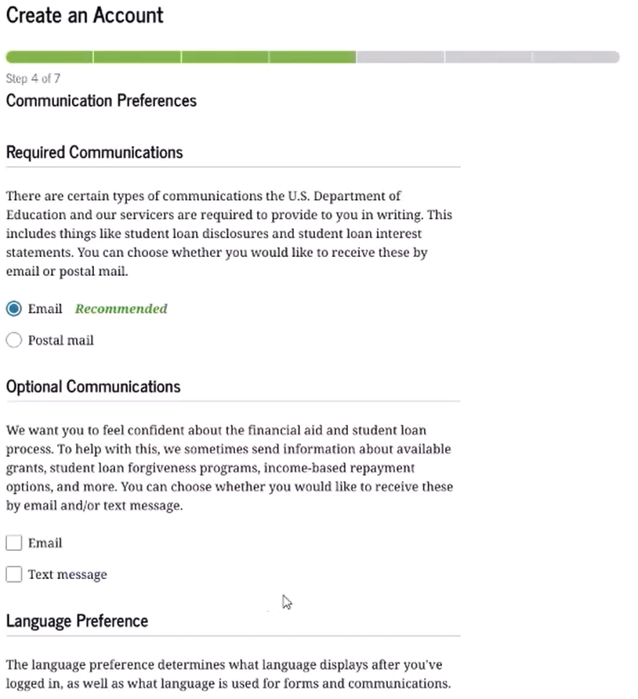
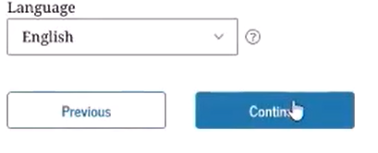
Account Creation Cont.
Steps
Select your communication and language preferences

Slide 13
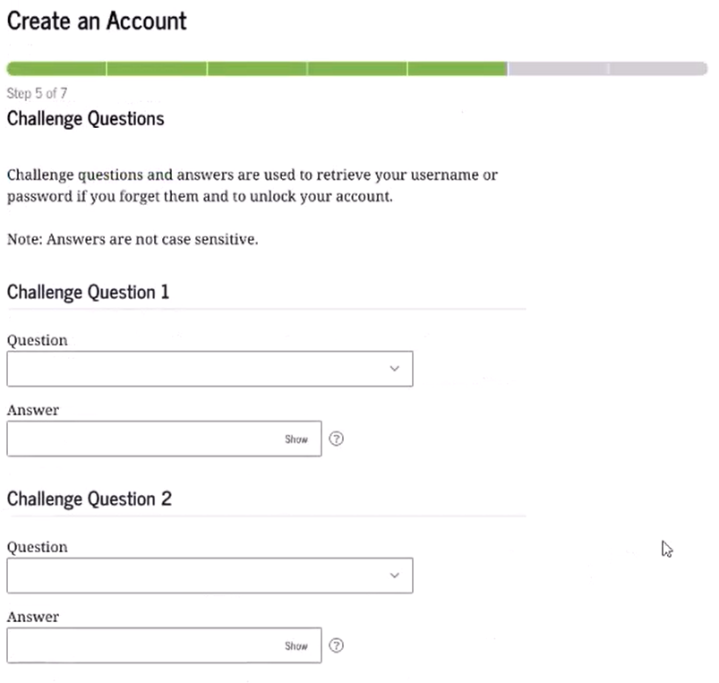
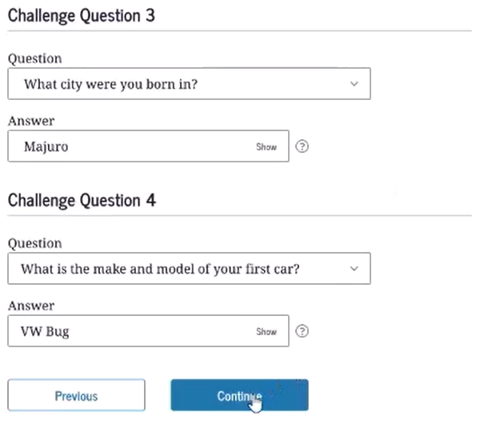
Account Creation Cont.
Steps
Create and answer your challenge questions
Confirm and verify your information

Slide 14
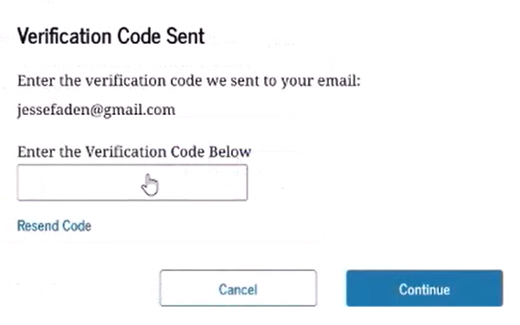
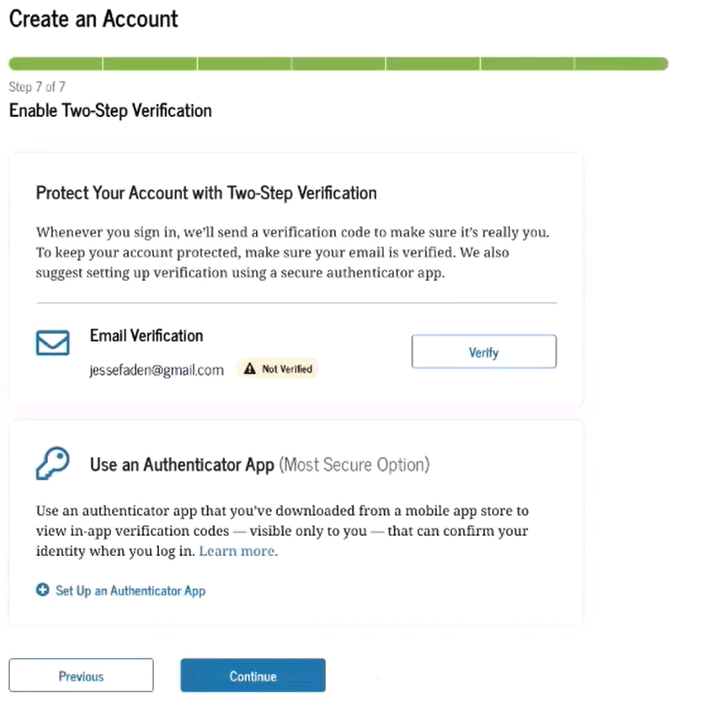
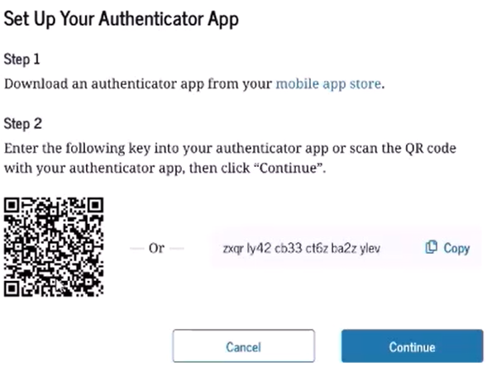
Account Creation Cont.
Steps
Use two-factor verification
Must confirm email (required) and phone number (if entered) are correct
May use authenticator app – not reliant on internet

Slide 15
Account Creation – No SSN
https://studentaid.gov/fsa-id/create-account/launch
Contributors without SSN can now create an account
This is meant for contributors without SSNs – students who do not have an SSN and are not an eligible non-citizen should not file the FAFSA.
Check the "I don't have a Social Security Number" box
Answer a series of knowledge-based identity questions
If user passes the knowledge-based process, account created and able to use immediately

Slide 16
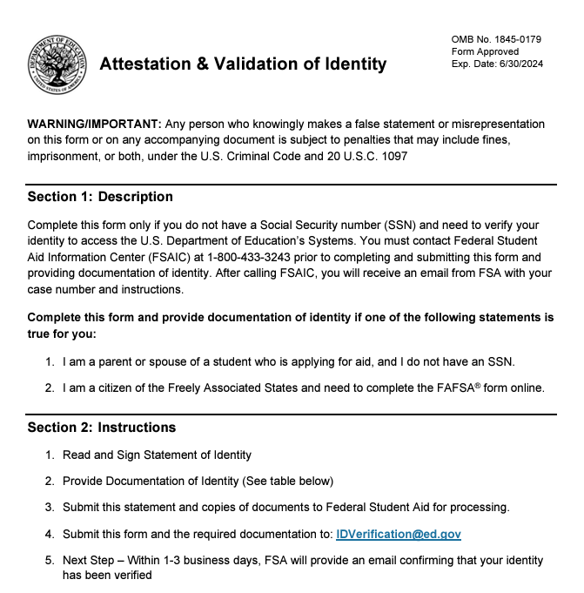
Account Creation – No SSN cont.
Documents cannot be expired
Group A
  U.S. State/Territory Driver's License
  U.S. State or City Identification Card
  Foreign Passport
Group B – Utility Bill + 1
  Municipal identification card
  Community ID
  Consular identification card
Email to idverification@ed.gov
1-3 business days

Slide 17
Account FAQs
Can someone else create my account for me?
No. It is important that only the account owner has control of their username and password information since this is how approval and consent is provided to the IRS.
Can I share my account info with others?
No. It is important that you keep your account info confidential as it is used for other federal aid processes, such as applying for federal loans.
What if a contributor is having issues setting up a StudentAid.gov account?
There could be several reasons why a contributor might be having issues setting up a StudentAid.gov account. If they are running into issues, they will need to contact Federal Student Aid for assistance.
Do I need to create a new account if I already have an account?
No. In fact, since your account is tied to your personal info, you cannot create a second account. You will need to use your existing account.

Slide 18
The 2026-27 FAFSA

Slide 19
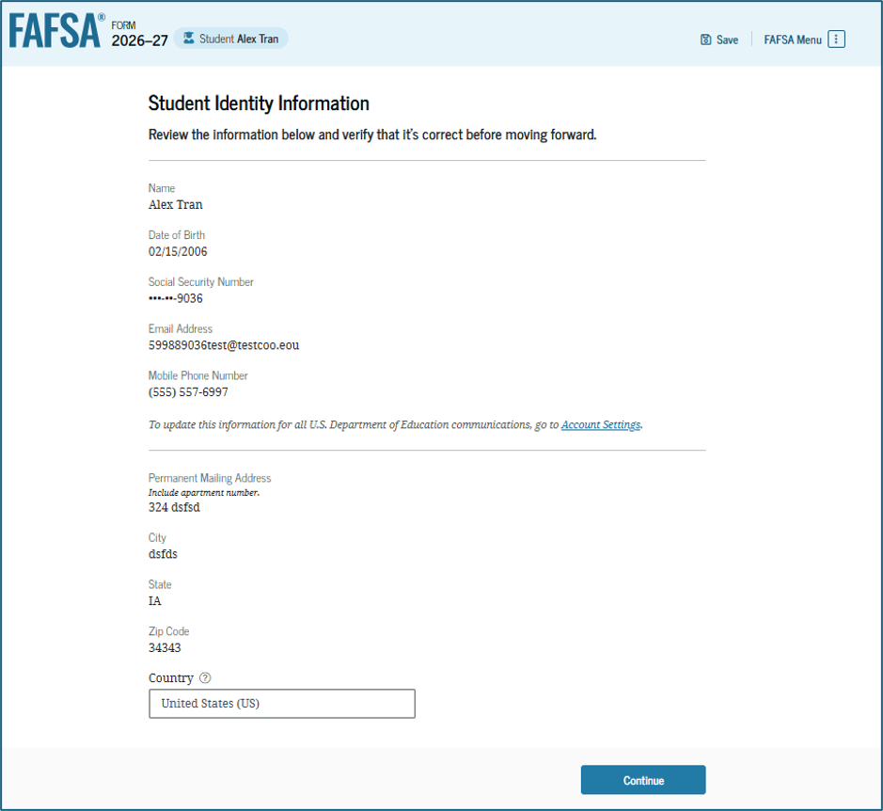
Student Information
When the student begins the FAFSA, they will verify their identity information is correct.
Incorrect information can cause significant processing delays.
To update any information listed, the student must access their account settings in studentaid.gov.

Slide 20
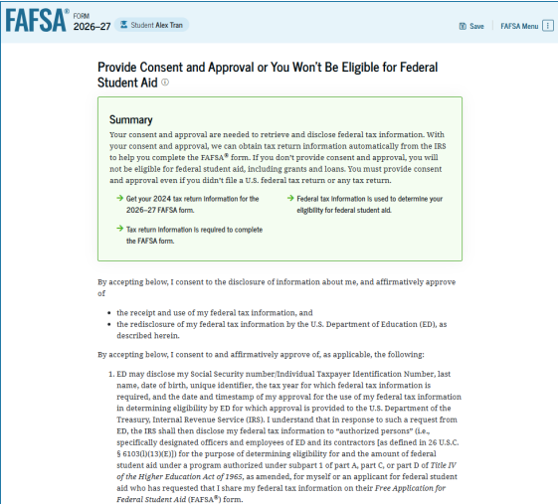
Consent and Approval
This page informs the student about consent, approval, and the use of federal tax information. Once the student provides consent and approval, their federal tax information is transferred directly from the IRS into the FAFSA® form to help complete the "Your Finances" section.

Slide 21
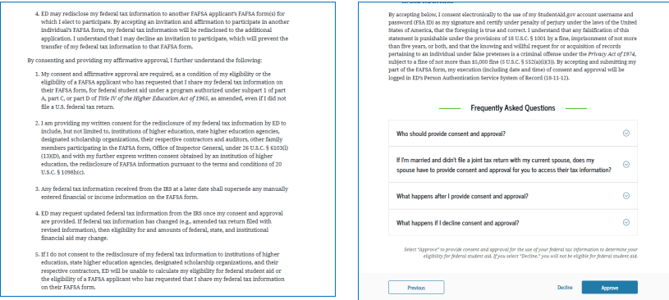
Consent and Approval Cont'd
This is a continuation of the consent and approval page. The student can expand and collapse FAQs about consent and approval. The student selects "Approve" to provide consent and approval and is taken to the next page.

Slide 22
Contributors
A Contributor is anyone whose financial information is required on the FAFSA. This is determined by the student’s dependency status and family situation — not by who is “willing” or “helping.”
Here’s the breakdown:
The Student - Always a contributor.
The Student’s Spouse
If the student is married at the time the FAFSA is completed.
The Parent(s)
If the student is dependent.
  Includes biological or adoptive parents.
  If parents are married → both parents are contributors.
  If parents are unmarried but living together → both parents are contributors.
  If parents are divorced/separated → the parent who provides the most financial support to the student is the contributor.
The Parent’s Spouse (Stepparent)
If the contributing parent is remarried — the stepparent is also a contributor.

Slide 23
Who is a Contributor?
A contributor is
You (the student),
your biological or adoptive parent(s)
your spouse, and/or,
your parent's spouse.
A contributor is not
Nonadoptive grandparents,
Foster parents,
Your fiancé, or
The other biological parent when they are not married to or don't live with the parent on the FAFSA form.

Slide 24
Identifying Contributors
These factors help to determine if other contributors are required on the student's FAFSA:
Dependency status,
Marital status, and
Tax filing status

Slide 25
Students are dependent unless...
Born before January 1, 2003
Veteran
Active-duty military
Married
Children or other dependents
Both parents are deceased
Foster care after age 13
Dependent/ward of the court after age 13
Emancipated minor
Legal guardianship
Homeless of at risk of being homeless
Unusual circumstances
If the student cannot answer yes to any of these questions they must report parent info on the FAFSA, even if they are self-supporting

Slide 26

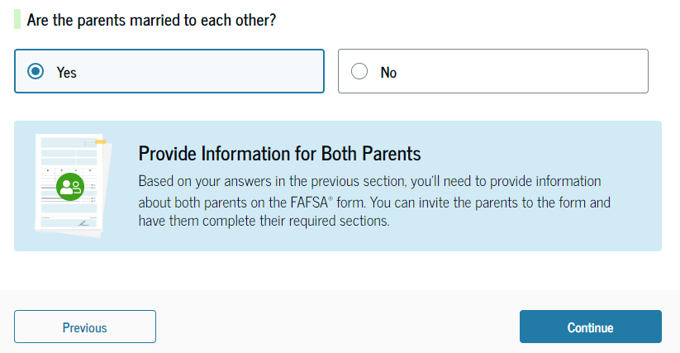
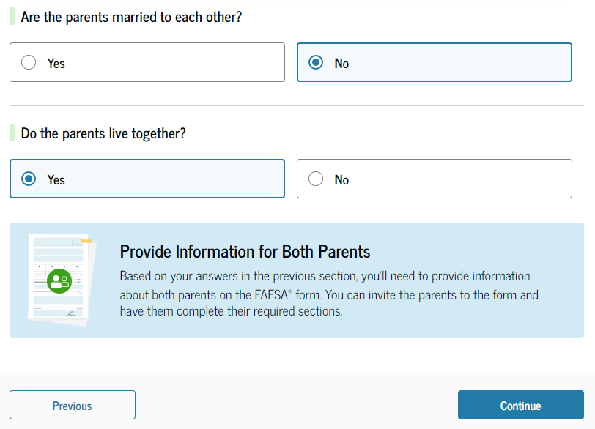
Reporting Parent Information
"Parent" is defined as a biological or adoptive parent
Parents are married
Parents are not married but live together
Parents are not married but live together

Slide 27

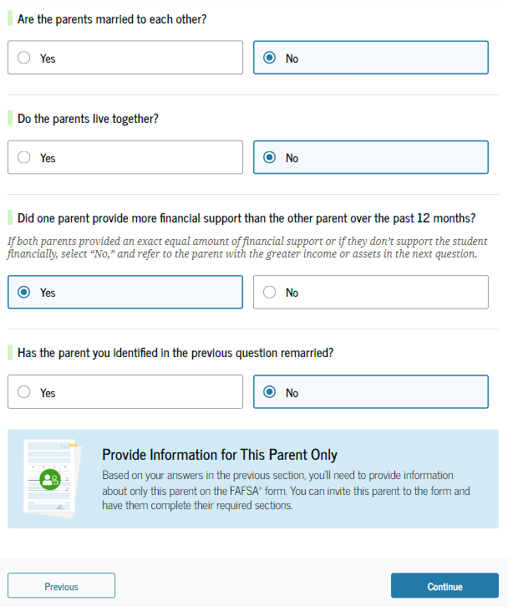
Reporting Parent Info Cont.
Parents are not married
Parents do not live together
One parent provided more financial support
Parent has not remarried

Slide 28
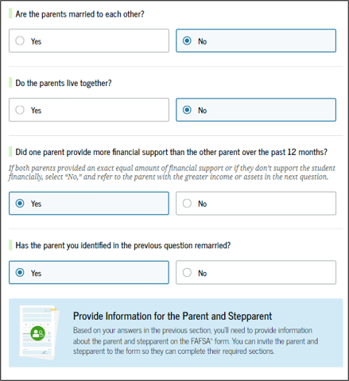
Reporting Parent Info Cont.
Parents are not married
Parents do not live together
One parent provided more financial support
Parent has remarried
  Must also report step-parent info

Slide 29
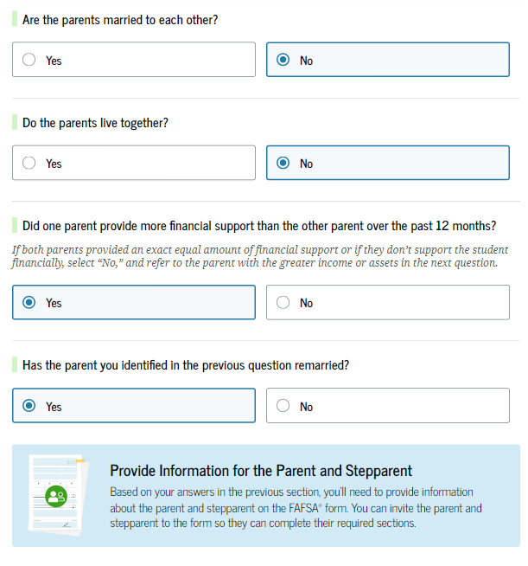
Reporting Parent Info Cont.
Parents are not married
Parents do not live together
Parents provided equal financial support
Report the parent with the greater income and assets
If that parent has remarried, must also report step-parent info

Slide 30
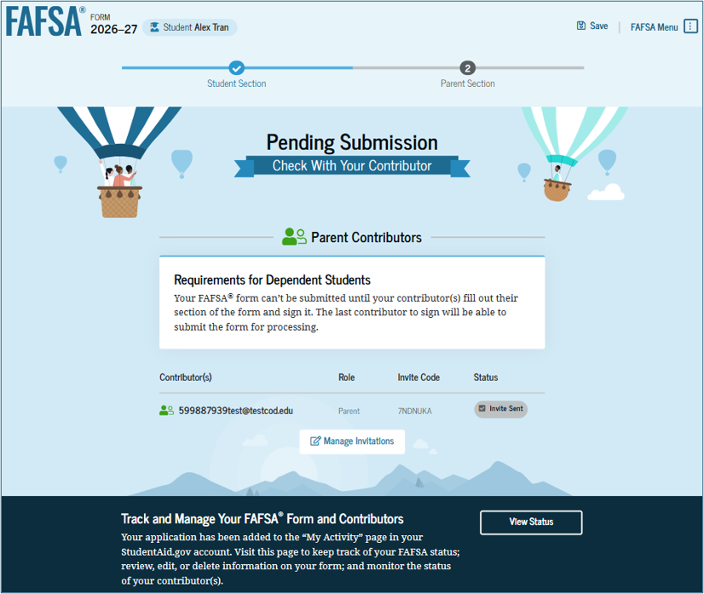
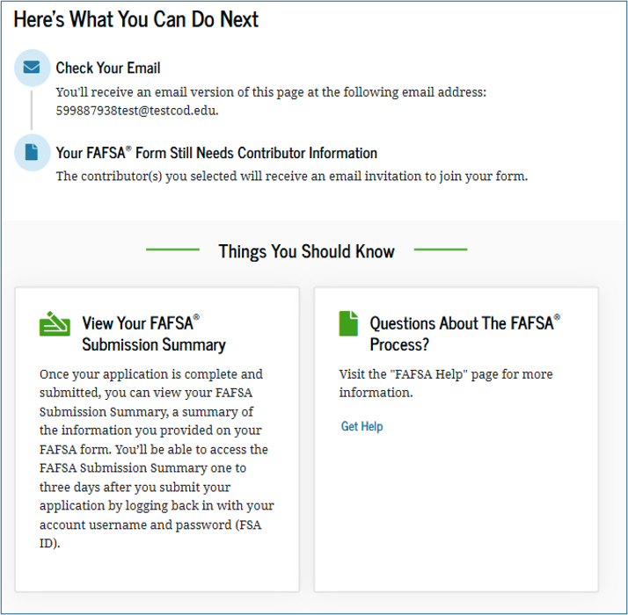
Student Invites Parent/Parents to Contribute on FAFSA Form

Slide 31
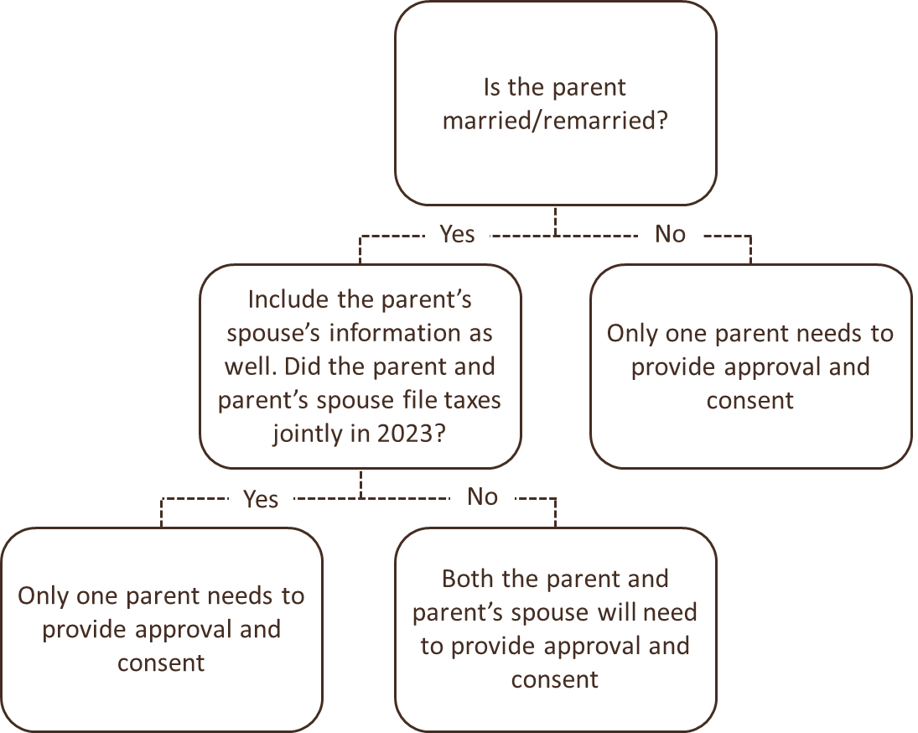
Contributors – who must set up an account and provide consent?
Student – Yes
Role = Applicant
Parent – Yes
Role = Parent Contributor
Parent's Spouse – Maybe
Role = Parent Contributor

Slide 32
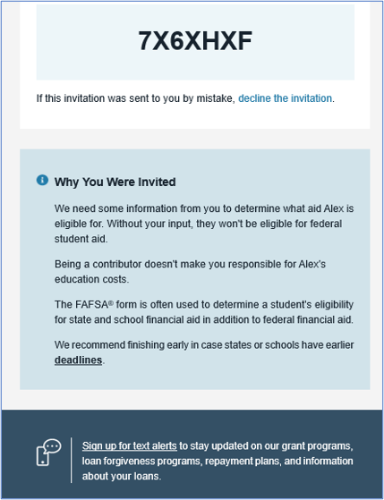
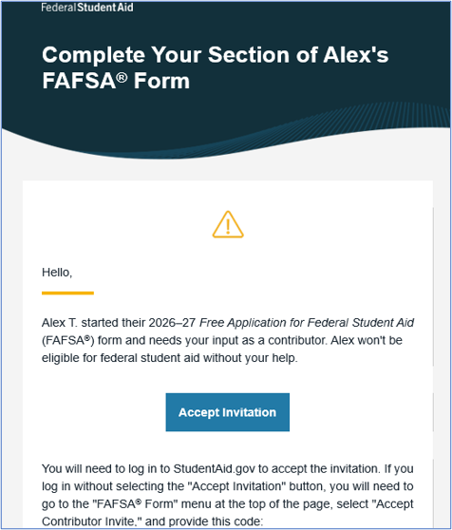
Parent Contributor Email
The parent(s) will receive an email that looks like this:
We will come back to the parent information section later…

Slide 33
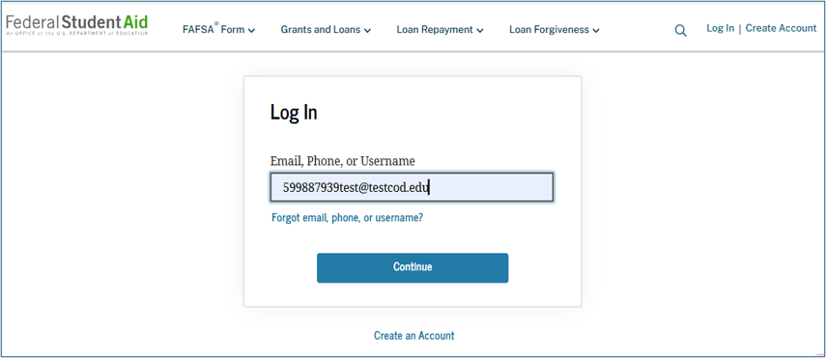
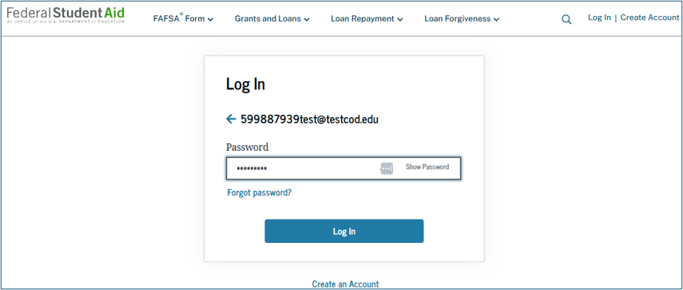
Parent Log-in
The parent is taken from their email to the "Log In" page to enter their credentials. To access the FAFSA® form, all users are required to have a StudentAid.gov account username and password. If the parent doesn't have a username and password, they can select "Create an Account."

Slide 34
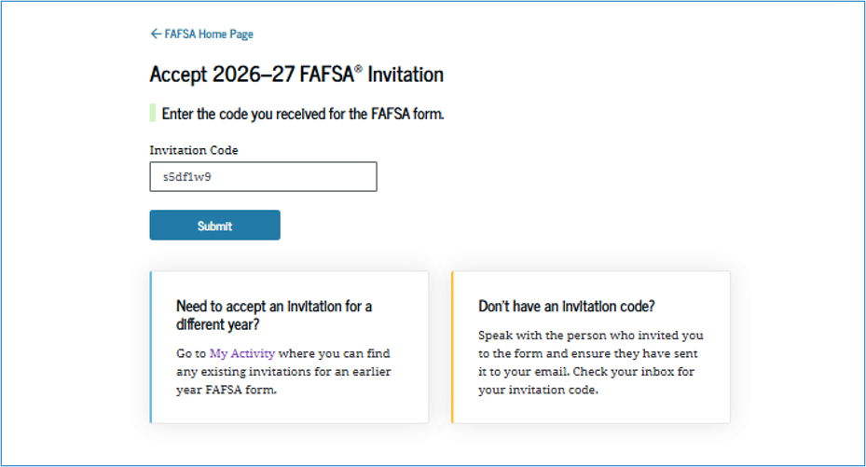
Parent Accepts Invitation
After logging in, the parent is taken to the "Accept 2026–27 FAFSA® Invitation" page. The invitation code from the parent’s email automatically fills in the text box if the parent used the link from the email.

Slide 35
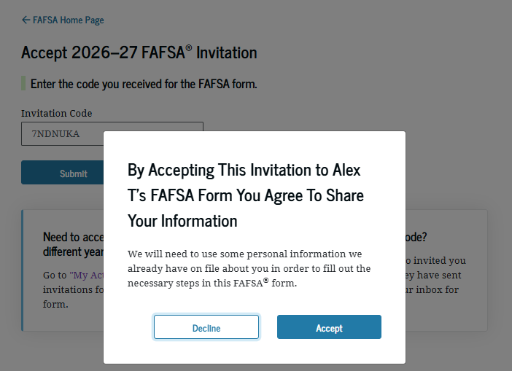
Parent Accepts Invitation (Continued)
When the parent selects "Submit," a pop-up window appears, confirming the student’s name and reminding the parent that their personal information is needed to fill out the student’s FAFSA® form. The parent selects "Accept" to agree to sharing their information and enters the FAFSA form.

Slide 36
WHAT IF I CAN'T PROVIDE PARENT INFORMATION?

Slide 37
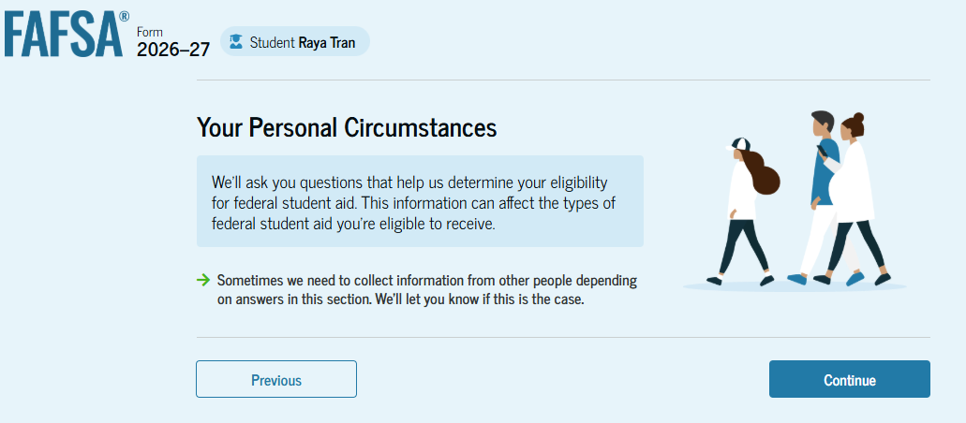
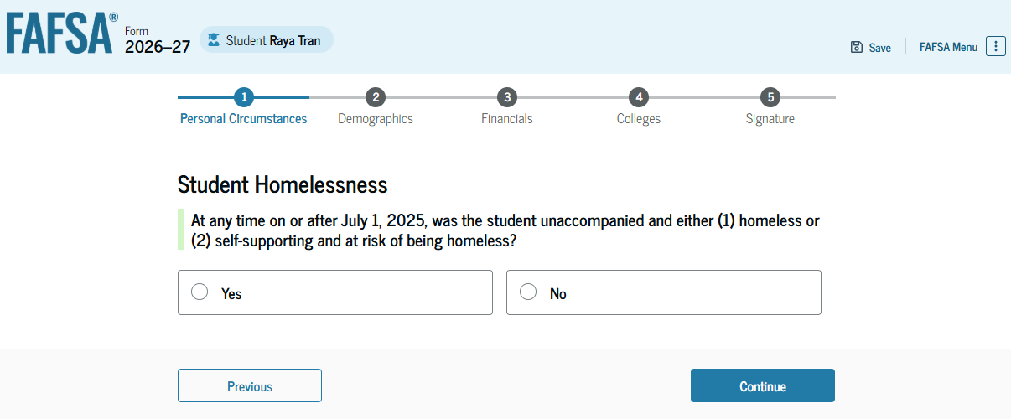
Remember
Students are not required to report parent information if they:
Were born before January 1, 2003
Are married
Are active duty/Veteran of US Armed Forces
Have children or other dependents
Were an Orphan/Ward of the Court/in Foster care at some point since age 13
Are an emancipated minor
Are in a legal guardianship situation
Are homeless/at risk of being homeless

Slide 38
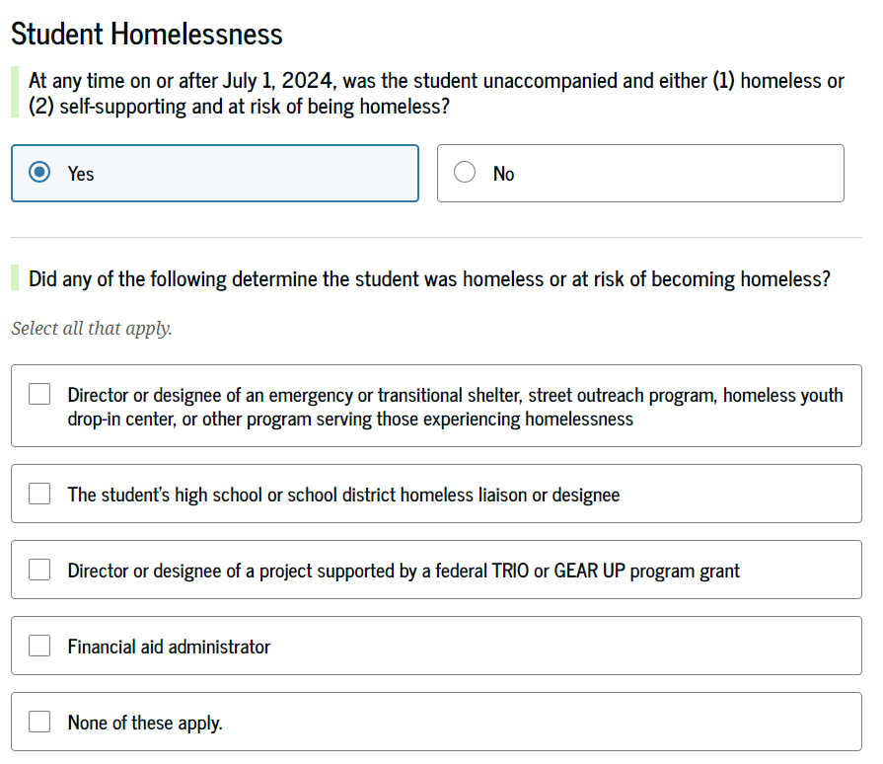
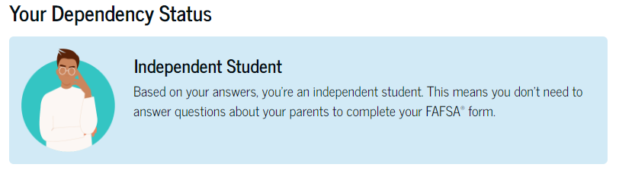
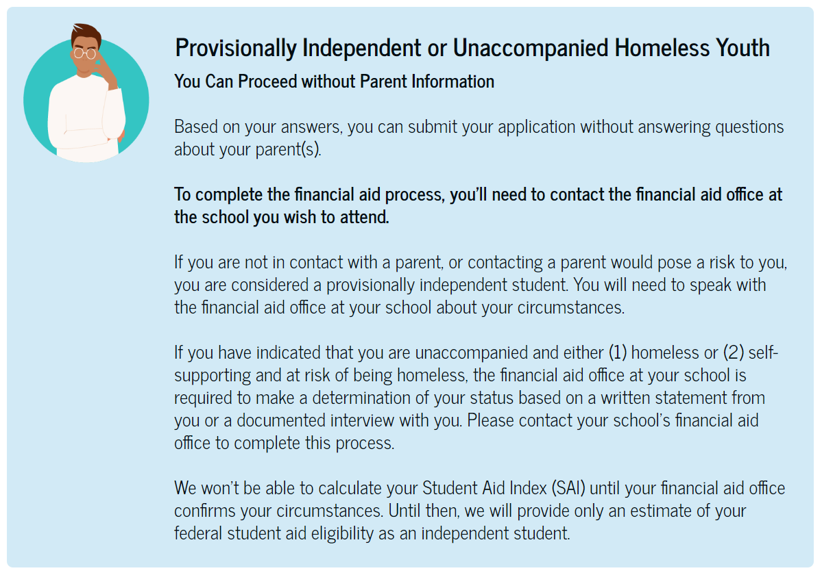
Homeless Students
Students who indicate they are homeless on the FAFSA are considered Provisionally Independent and the school must follow up within 60 days of enrollment.

Slide 39
Homeless Youth Determination
Who can make a homeless determination?
Director/Designee of an emergency/transitional shelter, street outreach program, drop-in center, or other program serving those experiencing homelessness
High School/District Homeless Liaison or designee – McKinney-Vento Representative
Director/Designee of TRIO/GEAR UP program
Financial Aid Administrators
If the student has received a documented determination from one of these authorities, the institution may not request additional documentation, proof, or statements unless it has conflicting information about the student’s status.
Sufficient documentation includes: A documented phone call, written statement, or a verifiable electronic data match.
If the student is unable to provide documentation from at least one of the entities, FAAs must review the student’s circumstances and make the determination themselves:
Based upon a written statement from, or a documented interview with the student that confirms that they are an unaccompanied homeless youth, or unaccompanied, at risk of homelessness, and self-supporting; and
Made without regard to the reasons that the student is unaccompanied and/or homeless.

Slide 40
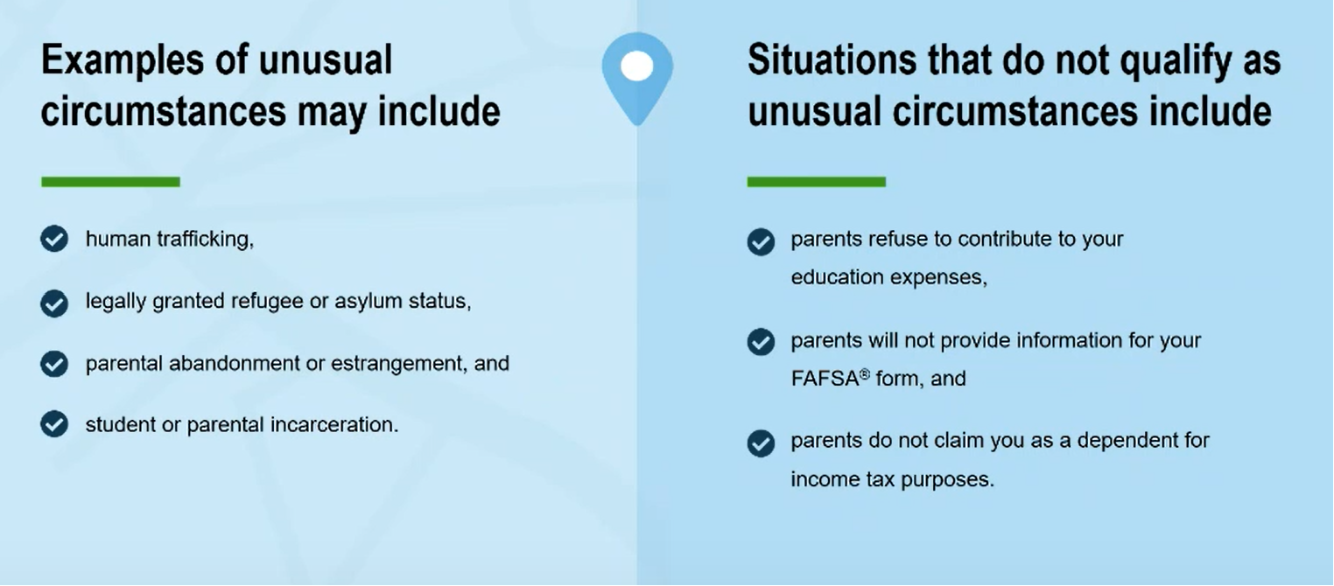
Unusual Circumstances

Slide 41
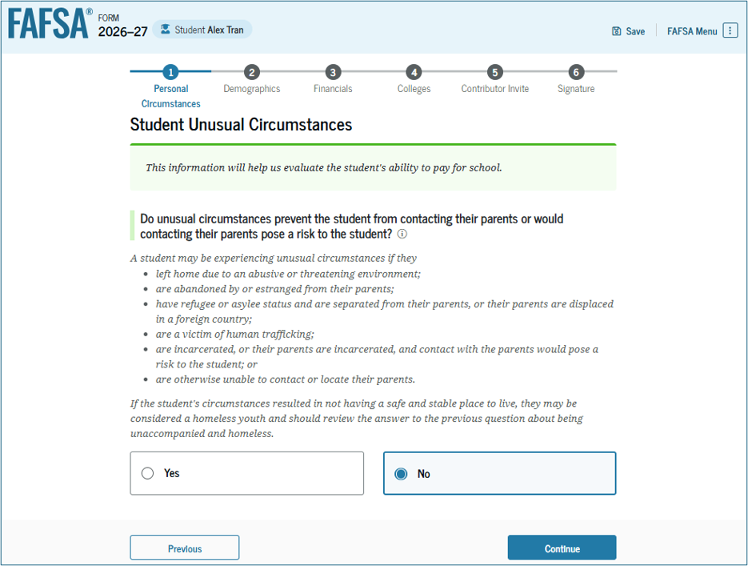
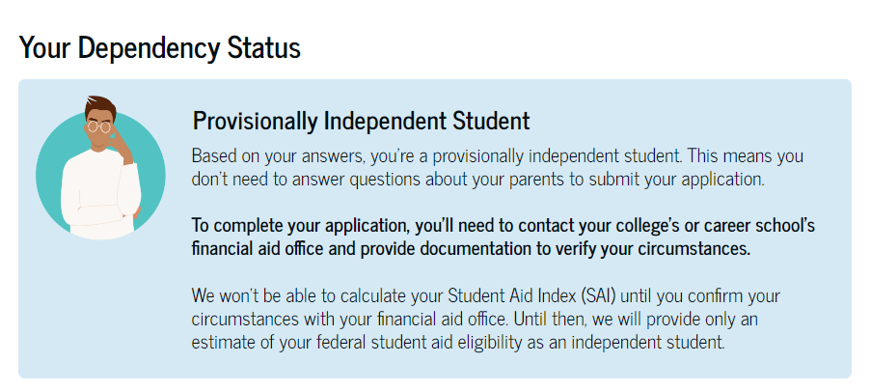
Unusual Circumstances
If the student selects yes, they will be allowed to submit the FAFSA without parental information and assigned a status of Provisional Independent Student but the student must follow up with the school. A Financial Aid Administrator will make a determination regarding dependency.

Slide 42
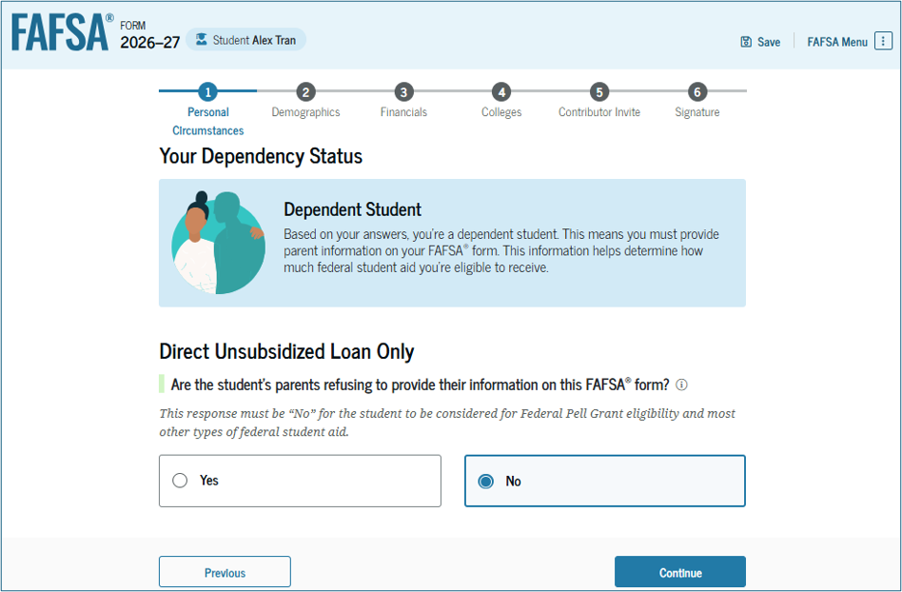
Unusual Circumstances
If the student does not have unusual circumstances, but their parent is unwilling to provide their information. Parental information is skipped, and the student has the option to receive a Direct Unsubsidized Loan only.
NO PELL GRANT, NO SUBSIDIZED LOAN.

Slide 43
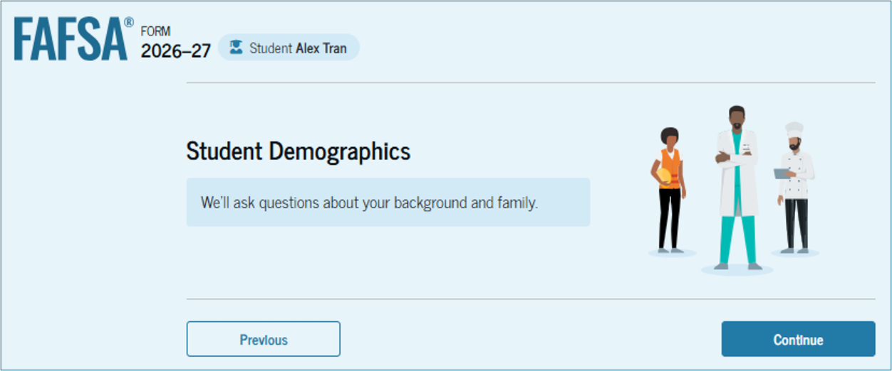
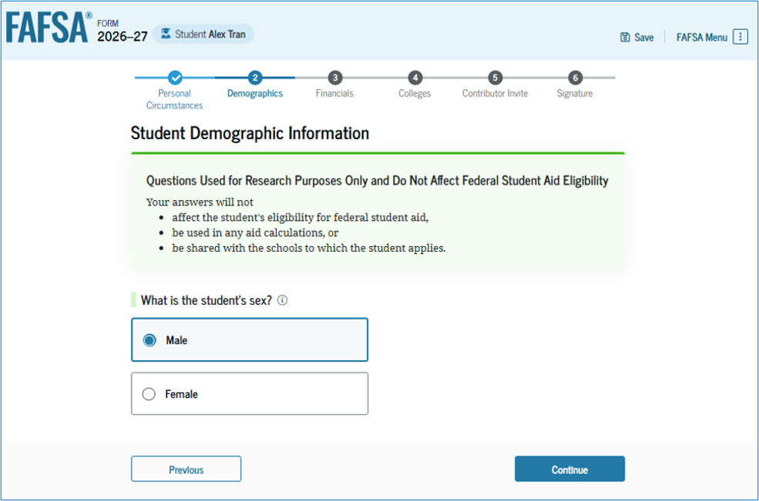
Student Demographics
The student will be asked a series of demographic questions. Some effect eligibility whereas others do not.
Gender & Race/Ethnicity
Citizenship
Parent Education Status
Parent killed in the line of duty
Student High School Information & Completion Status

Slide 44
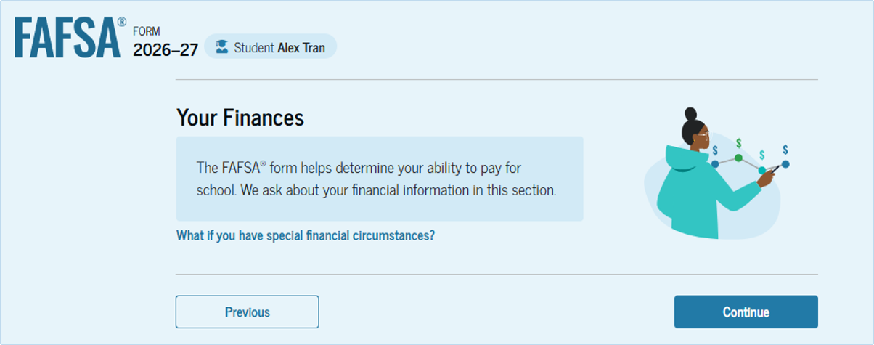
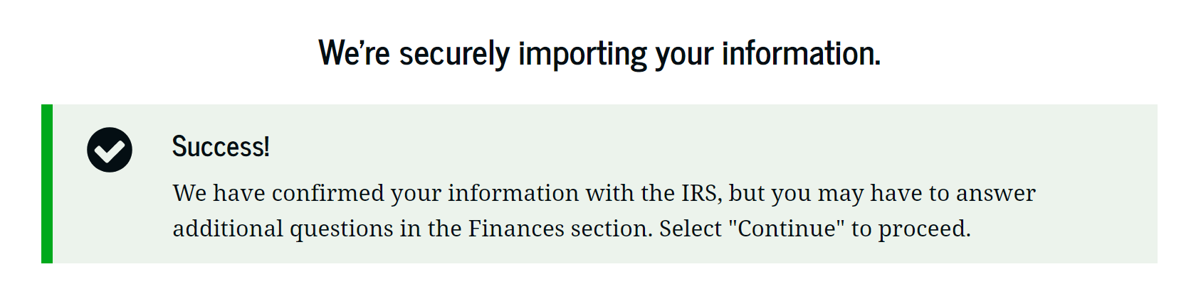
Student Finances
The student will be asked a series of financial questions.
The marital status question and tax filing question will determine if there is a match with the IRS. Marital Status and tax filing status must match.
If there is no match, the student must manually enter all of their tax return information onto the FAFSA.
If there is a match, the student will only be asked to enter IRA/Pension rollover amounts, grants/scholarships reported on a tax return (rare), foreign income exclusion (rare), cash/savings/checking amounts, and investment net worth.

Slide 45
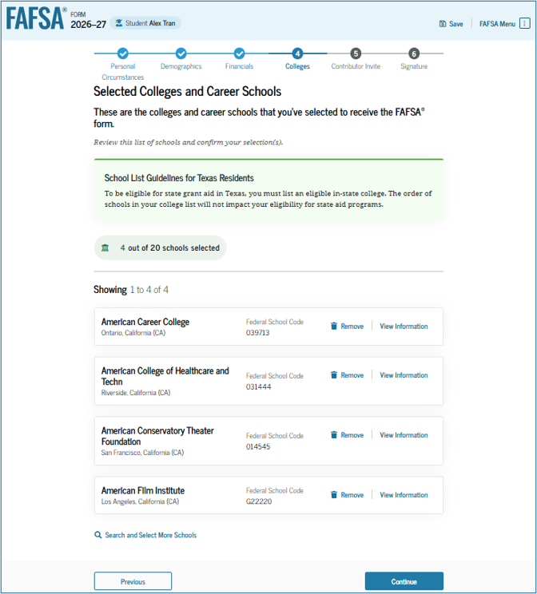
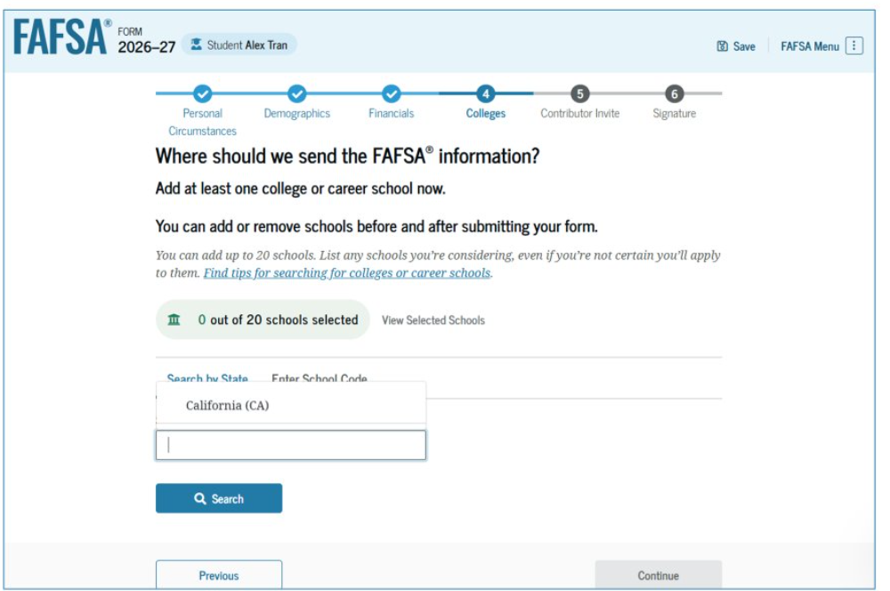
Select Colleges
The colleges entered here will receive the student’s FAFSA info. Students can add up to 20 colleges.

Slide 46
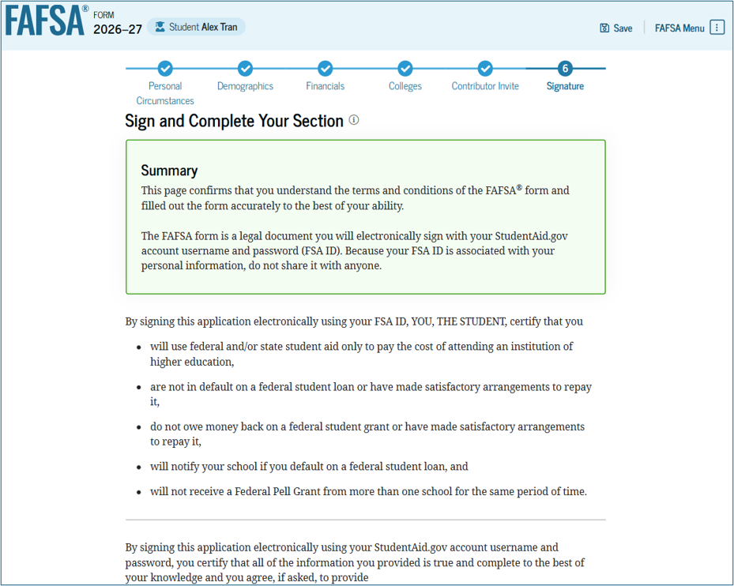
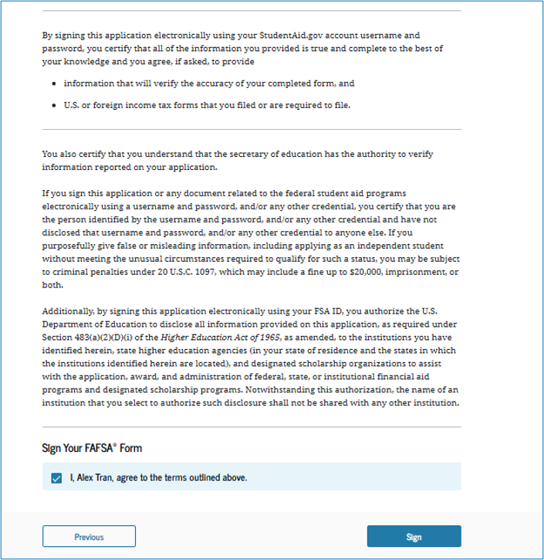
Student Signature
The student will be asked to agree to the terms and sign the FAFSA.

Slide 47
Upon signing, this screen will display next steps for the student:

Slide 48
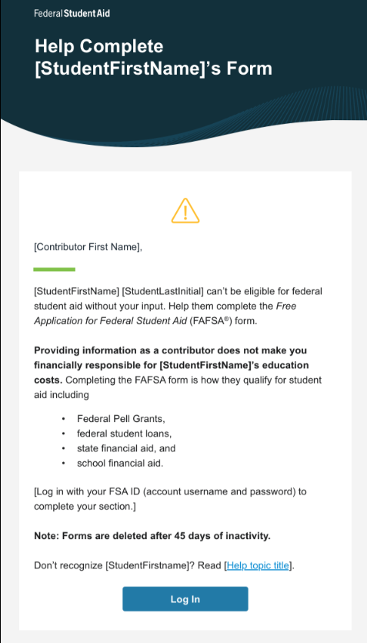
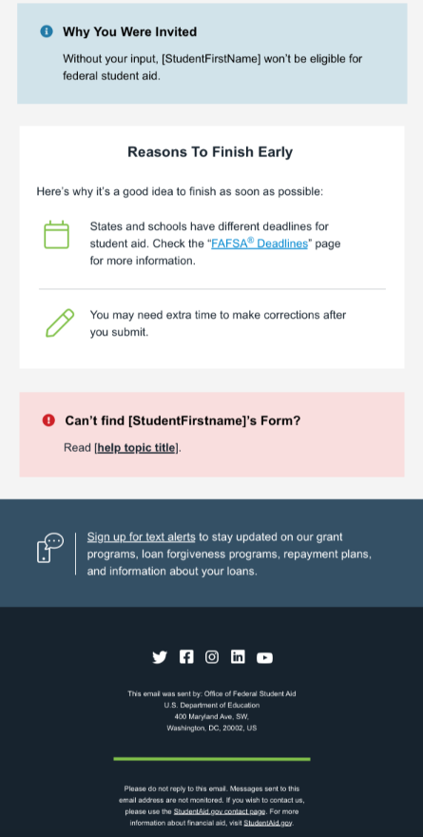
Parent Contributor Email
The parent(s) will receive an email that looks like this:
We will come back to the parent section later…

Slide 49

Parent (Contributor) Information
After successfully logging in, the parent is taken to their “My Activity” page. The parent sees an invitation to be a contributor on the student’s FAFSA® form.

Slide 50



Parent (Contributor) Approval and Consent
Parent will confirm their identity information and then consent to having their tax information used on the FAFSA. If consent is not provided, the student will be ineligible for aid.

Slide 51
IRS Direct Data Exchange
When a contributor logs in and provides consent, a match with the IRS will automatically attempt to occur.
  If the IRS has a tax record on file, it will automatically populate on the FAFSA. This is NOT optional.
  These fields will be hidden and not correctable.
  If there is no IRS match, the contributor will be asked to manually provide their information.
    Occurs when marital status does not match the tax filing status, taxes filed in a U.S. territory or foreign country, there is no tax return on file, victims of IRS tax-related identity theft.
If a match occurs it greatly reduces the financial questions that must be answered for both parent and student.

Slide 52

Parent (Contributor) Information
Parents will provide their demographic information, including current marital status, state of legal residence,
If the parent begins the FAFSA before the student they will be allowed to answer the student questions on address, marital status, college plans, and student personal circumstances.

Slide 53

Parent Financials
The parent will be asked a series of financial questions.
The marital status & tax filing questions determine if there is a match with the IRS. Marital Status and tax filing status must match.
If there is no match, the parent must manually enter all of their tax return information onto the FAFSA.
If there is a match, the parent will only be asked to enter the following:
Federal Benefits received: Earned Income Credit, Federal Housing Assistance, Free/Reduced school lunch, Medicaid, Refundable Credits under a Qualified Health Plan, SNAP, SSI, TANF, WIC
IRA/Pension rollover amounts
Grants/scholarships reported on a tax return (rare)
Foreign income exclusion (rare)
Number in College
There will be an option to update family size if that information does not match
the number of tax filers and dependents on the tax return.

Slide 54

Parent Financials – Investments and Assets
Parents must report the following assets & investments:
Annual Child Support Received
Balance of Cash, Savings, Checking Accounts
Current Net Worth
Current Net Worth of Business or Investment Farms
Net worth = Value of the investment – Debt owed against the investment
Negative value = $0

Slide 55
Investments and Assets
Investments include:
Real estate (don’t include the home in which you live);
Rental property (includes a unit within a family home that has its own entrance, kitchen, and bath rented to someone other than a family member);
Vacation homes; installment and land sale contracts (including mortgages held);
Trust funds; Uniform Gifts to Minors Act (UGMA) and Uniform Transfers to Minors Act (UTMA) accounts;
Money market funds; mutual funds; certificates of deposit; stocks; stock options; bonds; securities; tax shelters; and
529 college savings accounts designated for the student’s benefit.
Notes:
2 students and we have a 529 plan for both: If I fill out the first FAFSA and report the 529 amount it will pull it over to the second student and report the same amount.

Slide 56
Investments and Assets
Investments DO NOT include:
The home in which you (and if married, your spouse) live;
Cash, savings and checking accounts. This is reported in the Cash/Savings/Checking Accounts question on the FAFSA. Don't double report.
ABLE accounts;
The value of life insurance and retirement plans (401[k] plans, pension funds, annuities, noneducation IRAs, Keogh plans, etc.);
UGMA and UTMA accounts are considered assets of the student and must be reported as an asset of the student on the FAFSA form, regardless of the student’s dependency status. Parents don’t include UGMA and UTMA accounts for which they’re the custodian but not the owner.
The value of qualified education benefits or education savings accounts that are for the benefit of the parent’s other children (not the student).

Slide 57
Exempt from Asset Reporting
Applicant qualifies for maximum Pell
AGI + Schedules
  Applicant's parents’ (or student and student spouse for independent students) 2024 combined AGI is less than $60,000 and they do not file a Schedule A, B, D, E, F, or H
  AND
  They do not file a Schedule C
  OR
  their Schedule C has a net business income of not more than a $10,000 loss or gain
Means Tested Benefits
  Applicant or applicant’s parent(s) received a benefit under a means-tested Federal benefit program during the 2024 or 2025 calendar year. These benefits include: Earned Income Credit, Federal Housing Assistance, Free/Reduced school lunch, Medicaid, Refundable Credits under a Qualified Health Plan, SNAP, SSI, TANF, WIC
Families who meet this criteria will not have assets included in the SAI calculation
Notes:
Sudents need to have the student answer yes if they meet the FDA Free and Reduced Price School Lunch requirements

Slide 58

Other FAFSA Questions
Family Size – the form will now ask if the family size is different than the number of individuals claimed on their taxes. Unborn children can no longer be included in family size.
Number in College - Although the FAFSA will still ask for number in college, the formula to determine a student’s aid eligibility will no longer take the number in college into consideration. This could cause eligibility changes for students who have siblings in college.
529 plans – only the value of the 529 plan for the student listed on the FAFSA is reported.

Slide 59

Parent Signature
Parents will then be asked to sign and complete their section:

Slide 60

After all sections have been signed and submitted, a confirmation screen will be presented:

Slide 61
AFTER THE FAFSA IS SUBMITTED

Slide 62

FAFSA Submission Summary
Eligibility Overview:
Outlines estimates of aid and SAI
FAFSA Form Answers:
Outlines the answers they and their contributors provided; student can start a correction if any information is incorrect
School Information:
Student can see and compare colleges they selected.
Next Steps:
Informational comments as well as required steps such as making a correction or sending documentation to college(s).

Slide 63




After the FAFSA is Submitted
Financial Aid Offer Timeline
Private schools
Public Schools
Community Colleges
Technical Colleges
FAFSA processed 1-3 days
Sent to schools
School notifies of next steps
Email
Mail
Portal
Complete Financial Aid File

Slide 64
Different Types of Aid
Grants
  Pell Grant
  Federal Supplemental Educational Opportunity Grant (SEOG)
  Teacher Education Assistance for College and Higher Education (TEACH)
  State grants
Scholarships
  Institutional
  State
  Private/Third-party
Loans
  Fed Direct Subsidized
  Fed Direct Unsubsidized
  Parent Loan for Undergraduate Students (PLUS)
  Private
Work-Study
  Federal
  State

Slide 65
Verification
A process to confirm that info on the FAFSA is accurate.
DDX will make students less likely to be selected.
Random selection process.
The FAFSA Submission Summary will indicate if a student is selected for verification with an asterisk (*) next to the SAI and a comment in the “Application Status” section.
If selected, students/families will need to provide requested documents to their college.

Slide 66
Special Circumstances
Loss of income due to job loss or reduction in wages
Separation, divorce, death of a parent/spouse
Medical or dental expenses
Siblings/dependents or parent enrolled in college
Students experiencing one or more of these situations should contact the school’s financial aid office to discuss their process as it is different at each school.

Slide 67
Common Issues
Unsubsidized loan only question being answered incorrectly
1st bachelors degree question being answered incorrectly
Parent invite issues – must enter valid email address
Student circumstances – read these carefully
Paper FAFSAs – LAST RESORT (or NOT AT ALL!) all sorts of data issues here and they are taking forever to process.
  And if something is wrong, they can’t correct anything via paper and prompted to do it online, but it can’t be corrected online
Changes or corrections to marital status
  Cannot currently be corrected by school
Accounts created by someone other than intended user

Slide 68
Additional Resources
Federal Student Aid (FSA) Training Center - https://fsatraining.ed.gov/
Login as a guest for in depth training on the FAFSA, formulas, financial aid processes, etc.
  2025-26 FAFSA Prototype - https://fsapartners.ed.gov/fafsa-prototype/2526
  Access code: prototype2526
Toolkits and Resources
  National College Attainment Network (NCAN) Better FAFSA Training Toolkit - https://www.ncan.org/page/better-FAFSA-training-toolkit - handouts, one-pagers, comparison charts, presentations, etc.
  FSA Toolkit for Counselors - https://financialaidtoolkit.ed.gov/tk/ - search by topic, resource type and audience.
FAFSA Issue Alerts Page - https://fsapartners.ed.gov/knowledge-center/topics/fafsa-simplification-information/2024-25-fafsa-issue-alerts

Slide 69

FAFSA Virtual Drop-In Help Events
Date: January 22, 2026
Time: 5-7:30 PM
Date: February 19, 2026
Time: 5-7:30 PM

Slide 70
Questions

Slide 71
Thank
you

