Slide 1
WHAT COMES AFTER THE FAFSA? NEXT STEPS, FINANCIAL AID OFFERS, AND COLLEGE AFFORDABILITY
KASFAA HIGH SCHOOL COUNSELOR & COLLEGE ACCESS PERSONNEL TRAINING 2023
TONA STONE-BENEDICTINE COLLEGE
SCOTT SPONHOLTZ-UNIVERSITY OF KANSAS MEDICAL CENTER
LETICIA GRADINGTON-UNIVERSITY OF KANSAS
DANIELLE SULLIVAN-JOHNSON COUNTY COMMUNITY COLLEGE

Slide 2
TODAY WE WILL COVER…
What Does the FAFSA Do?
Understanding Net Costs
Types of Financial Aid
Comparing Financial Aid Offers
Special Circumstances
Applying for Loans
College Billing
Managing Finances
More Resources

Slide 3
WHAT DOES THE FAFSA DO?
Assess Financial Strength
EFC & COA
Two building blocks of financial aid. Expected Family Contribution determined by FAFSA, Cost of Attendance determined by school
Determines what type of aid the student qualifies for based on family’s ability to pay for educational expenses
COA – EFC = Financial Need
Some aid programs require the family to demonstrate financial need

Slide 4
VERIFICATION & OTHER REQUIRED TO DO ITEMS
VERIFICATION
REJECTED FAFSA
DATABASE MATCH ISSUES “C CODES”

Slide 5
No EFC Calculated
Missing Signature
SSN
Conflicting Information
REJECTED FAFSA
Schools cannot proceed until the student resolves issue by correcting the FAFSA
Lack of a signature, either by parent or student
01
Social Security Administration cannot confirm the SSN reported for student or parent
Conflicting income information or conflicting tax information
02
03

Slide 6
REJECTED FAFSA
01
02

Slide 7
Resolved by student or school
SSA
NSLDS
Homeland Security
DATABASE MATCHES “C-CODES”
Confirmation of student citizenship through Social Security Administration
FAFSA information sent through federal databases to catch fraud - EFC calculated - no aid until resolved
01
National Student Loan Data System checks for loan default, unusual enrollment history, loan and Pell aggregates
Confirmation of student eligible non-citizenship status
02
03

Slide 8
DATABASE MATCHES “C-CODES”
01

Slide 9
VERIFICATION
Process used by the institution to check accuracy of the information the student and/or parent(s), provided on the FAFSA.
Students are selected for verification by Federal Student Aid or the institution.
Information is verified through documentation, such as a signed statement or worksheet attesting to the accuracy of the information. Verification ensures accurate eligibility for need-based federal student aid.

Slide 10
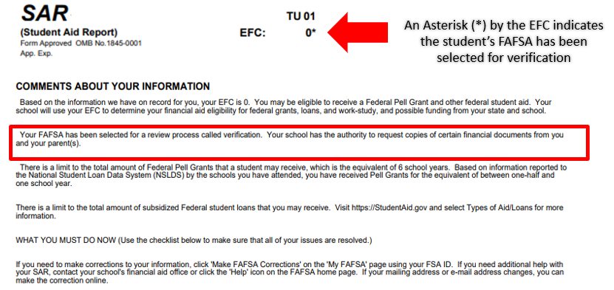
VERIFICATION

Slide 11
HOW DOES A STUDENT COMPLETE
VERIFICATION?
Schools may collect verification materials via an online portal, mail, or in person. Students/parents may be asked to verify a variety of things depending on their situation. Using the IRS Data Retrieval Tool in the FAFSA will speed up the process!
Adjusted Gross Income (AGI)
U.S. Income Tax Paid
Household Size
Number in College
Other Items on Tax Return
Income Earned from Work
Household Size
Number in College
Verification of Non-Filing

Slide 12
WHAT KIND OF DOCUMENTS DOES A STUDENT TURN IN?
Verification Worksheet
Dependent students may need parent signatures
The Verification process is school specific, and the student will need to reach out to the school regarding what to submit and how to submit. Generally speaking, students may need to submit:
Tax Documents
Copies of all tax returns + all schedules. Tax Transcripts if tax return copies are not available
W-2s
Or other documentation of income such as a Wage and Income Transcript
Verification of Non-Filing
For those who do not file taxes

Slide 13
IRS DRT
WHOA!
In some cases, using the IRS Data Retrieval Tool when filing the FAFSA can reduce Verification Paperwork. Some schools may not require copies of tax returns if the IRS DRT is used. If a student does not use the IRS DRT when initially filing the FAFSA, they can go back and make a correction to use the tool. This is a good solution for students/parents who cannot obtain copies of their tax returns or tax transcripts.

Slide 14
EFC IS DETERMINED! WHAT’S NEXT? COA!
Tuition & Fees
EFC
Books & Supplies
After EFC, school sets a budget – Cost of Attendance (COA)
Housing & Meals
COA
Transportation
Other costs could include Computer Purchase, Childcare, Disability expenses & Study Abroad
Personal/ Miscellaneous

Slide 15
Start with the school
Special Circumstances: FAFSA Changes
Unusual Circumstances: Dependency Override
Special Circumstances: COA Adjustments
SPECIAL CIRCUMSTANCES & UNUSUAL CIRCUMSTANCES – PROFESSIONAL JUDGMENTS
The student/family starts this process with the school after filing the FAFSA. Cannot be done on their own. Schools differ on what they allow
FAFSA doesn’t reflect current finances: loss of income/resources, marital status changes, medical/dental expenses, parent in college
01
Student cannot provide parental information. FAFSA dependency status isn’t based on who claims or doesn’t claim on taxes or financially self-sufficiency
Increased expenses: books/supplies, transportation, childcare, housing, private school tuition
03
02

Slide 16
DIRECT AND INDIRECT COSTS
Direct
Costs
Indirect
Costs
Paid directly to the school
Paid by the student
-Tuition
-Fees
-On-Campus Housing & Meals
-Off-Campus Housing & Meals
-Transportation
-Personal/Miscellaneous
-Books
-Parking Permit
-Activity Fees

Slide 17
TYPES OF FINANCIAL AID
SCHOLARSHIPS
WORK-STUDY
GIFT AID
SELF-HELP AID
GRANTS
LOANS
Institutional, Private/outside, State
Federal $$ paid in exchange for campus employment. Received via paycheck
Federal (Pell, SEOG, TEACH), State (KCG, Access Missouri), Institutional
Federal Direct Student Loans (sub/unsub) & Parent Loans, Private Loans

Slide 18
EVALUATING FINANCIAL AID OFFERS (AID PACKAGES)
-Most expensive college doesn’t always mean the best education.
-Compare college costs to career earnings and earnings to debt level – College Scorecard.
-Consider a community college first and then transfer to a 4-year to save $$.
-How much of the aid is renewable? What are the renewal criteria?
-How much of the aid package is gift aid and what is the net cost after gift aid?
-What amount of loans are they offering? Balance between student and parent.
-Are there scholarships the school offers later once a student is accepted to a major?
-Are there private scholarships that the student has won and can apply to bill?

Slide 19
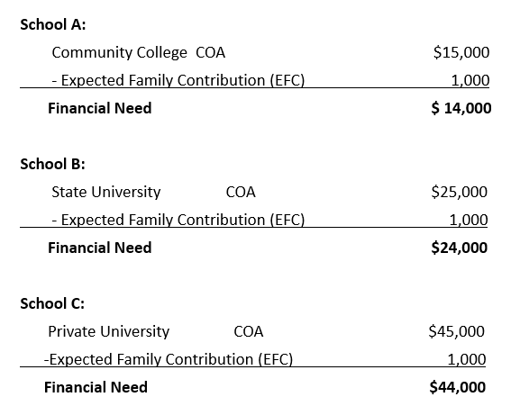
COMPARING 3 SCHOOLS WITH THE SAME EFC
Remember, the COA is made up of both Direct and Indirect costs

Slide 20
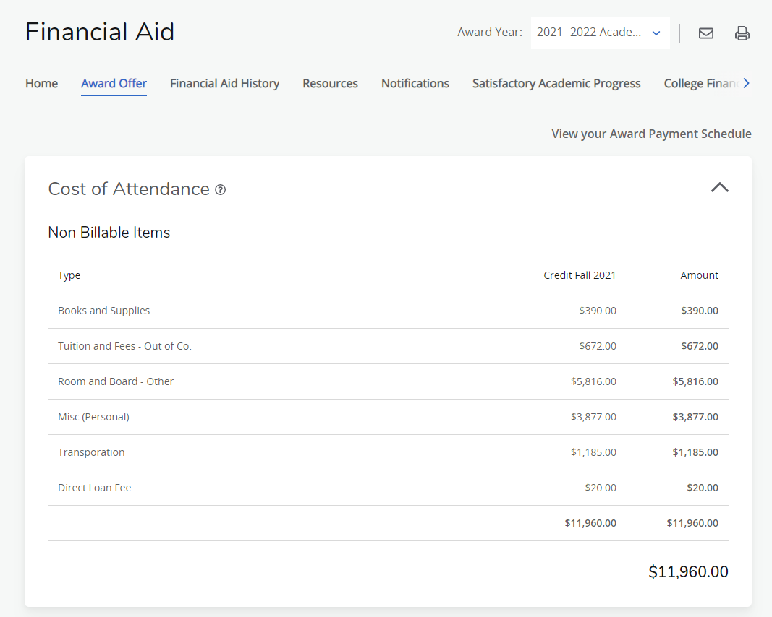
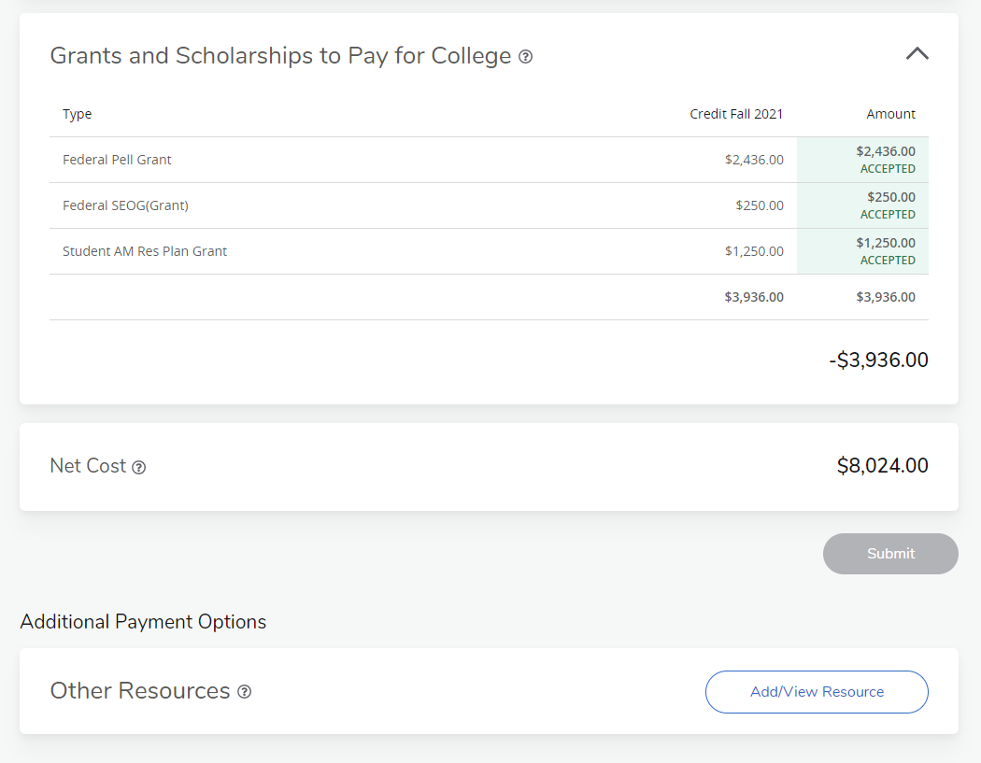
FINANCIAL AID OFFER 2 year public

Slide 21
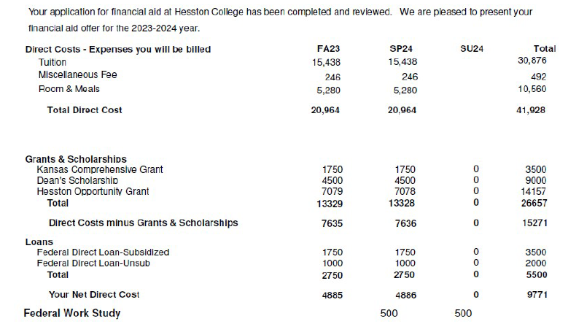
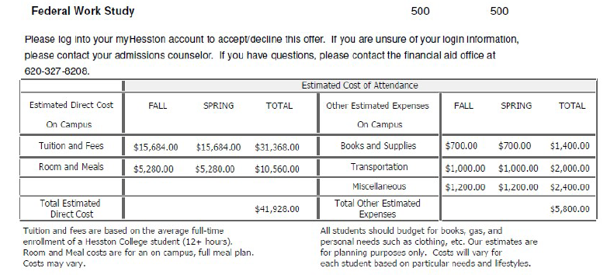
FINANCIAL AID OFFER 2 year private

Slide 22
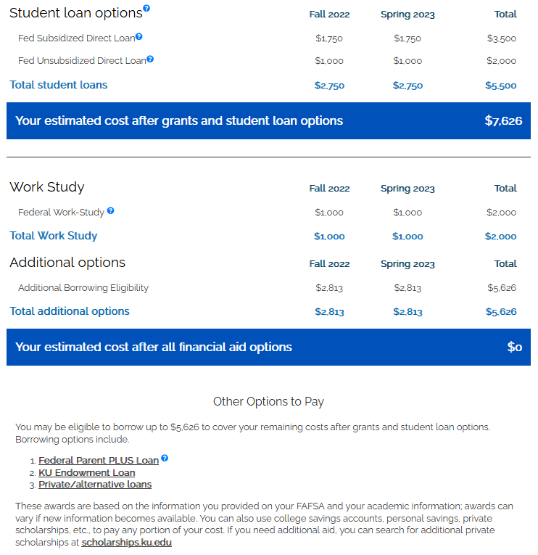
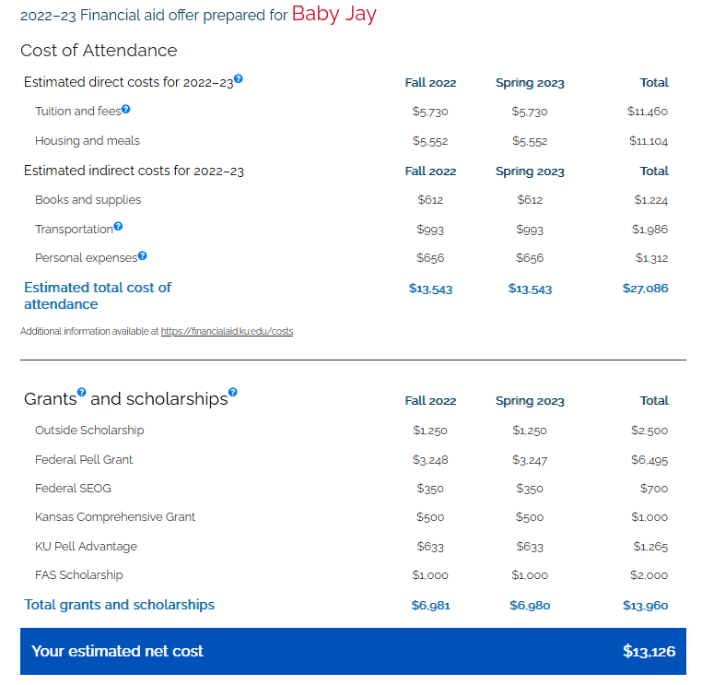
FINANCIAL AID OFFER 4- year public

Slide 23
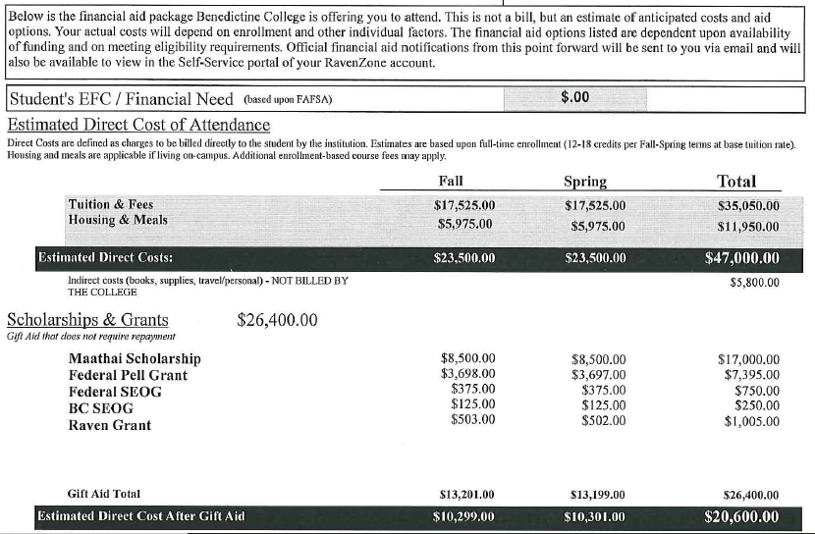
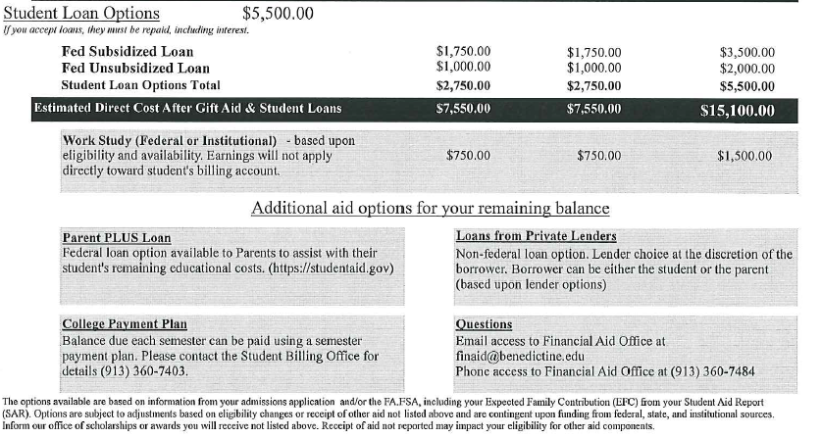
FINANCIAL AID OFFER 4-year private

Slide 24
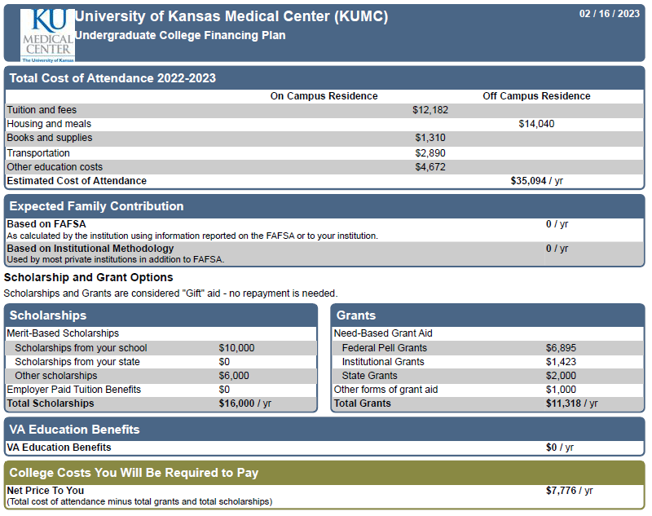
FINANCIAL AID OFFER Medical School
Selected KBOR Aid Programs:
https://kansasregents.org/students/student_financial_aid/scholarships_and_grants
Kansas Military Scholarship
Kansas National Guard
Educational Assistance
Kansas Nursing
Service Scholarship

Slide 25
CAN WE NEGOTIATE?
-It's unlikely that a public institution will negotiate beyond what their original offer was, but you never know. It’s possible to ask for an exception to their scholarship criteria (e.g. student had a 23 ACT and a 4.0 and scholarship requires a 24 ACT and a 3.5.)
-Private institutions may have more institutional financial aid to “play with;” they may be able to negotiate if you’ve received a better offer somewhere else.
-If the information you provided on your original financial aid application (either via the FAFSA or via the school’s own aid application process) has changed, you could request a review.

Slide 26
LEARNING ABOUT LOANS!
Repayment begins 6 mo. after graduation, leaving, dropping below
half-time
Subsidized: no interest while in school & grace period
Interest Rate: 4.99%
Origination Fee: 1.057%
FEDERAL DIRECT STUDENT LOANS
Start with the FAFSA
First Time Borrowers:
Loan Entrance Counseling
Master Promissory Note
Unsubsidized: interest accrues for the lifetime of loan
Loan assigned to a loan servicer
The school receives the loan funds first to apply to charges. Excess refunded to student
Many repayment options & some loan forgiveness opportunities

Slide 27
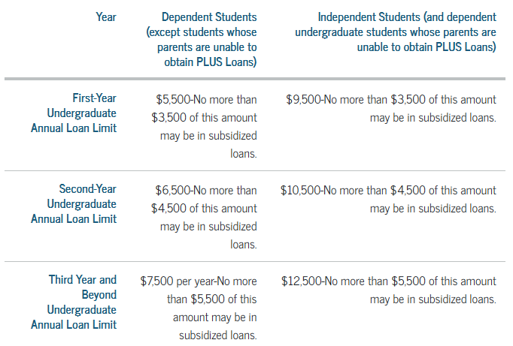
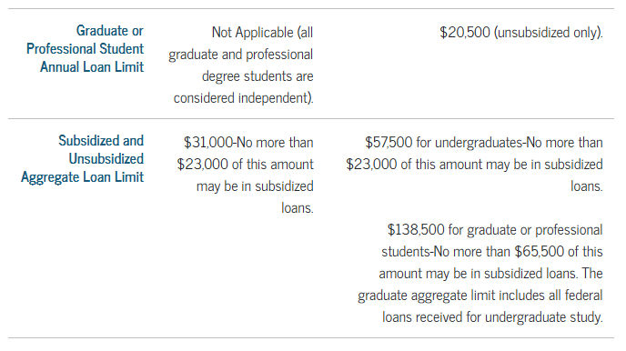
LOAN LIMITS

Slide 28
LEARNING ABOUT LOANS!
First-time student loan borrowers complete at studentaid.gov. GOAL: understand details of the loans they are borrowing and understand repayment graduating, or leaving school.
ENTRANCE COUNSELING
MASTER PROMISSORY NOTE - MPN
Students electronically sign a Master Promissory Note (MPN) at studentaid.gov. Good for 10 years, and multiple loans can be accepted without signing a new MPN.
EXIT COUNSELING
Completed at studentaid.gov when a student graduates, leaves, or drops below half-time.

Slide 29
LEARNING ABOUT PARENT LOANS!
Biological/Adoptive Parents, stepparents listed on FAFSA may apply
Fill out the PLUS app at studentaid.gov after filing the FAFSA
Grandparents, legal guardians, etc. may not apply unless legally adopted student
Interest Rate: 7.54%
Origination Fee: 4.228%
About $846 on $20,000
FEDERAL DIRECT PARENT LOANS (PLUS LOAN)
Start with the FAFSA
Goes through a credit check
Max amount is COA minus any other financial aid
Unsubsidized: interest accrues for the lifetime of the loan
Repayment begins 60 days after loan disburses – while student is in school
The school receives the loan funds first to apply to charges. Excess amount refunded to student (or parent for PLUS)
PLUS loan cannot transfer to the student. It is the parent’s debt
Loan can be deferred if student is enrolled at least half-time

Slide 30
PLUS LOAN – ADVERSE CREDIT
What is considered adverse credit history?
OPTIONS:
1. One or more debts with a total combined outstanding balance greater than $2,085 that is 90 or more days delinquent as of the date of the credit report, or that have been placed in collection or charged off (written off) during the two years preceding the date of the credit report; or
2. During the five years preceding the date of the credit report, you are in default, discharge of debts in bankruptcy, foreclosure, repossession, tax lien, wage garnishment, or charge off/write-off of a federal student aid debt.
Appeal the credit decision, complete PLUS credit counseling and new MPN
Apply with an endorser, complete PLUS credit counseling and new MPN
If neither option pursued, student can receive add’l unsub loan ~ $4000 - $5000

Slide 31
LEARNING ABOUT LOANS – INSTITUTIONAL LOANS
What are the loan fees?
What is the interest rate?
When does repayment begin?
Must I meet Satisfactory Academic Progress?
Minimum hours of enrollment?
What are the repayment options?
Colleges may have private loan programs where the school is the lender – long term and short-term loans

Slide 32
LEARNING ABOUT LOANS – PRIVATE LOANS
What are the loan fees?
What is the interest rate?
When does repayment begin?
Must I meet Satisfactory Academic Progress?
Minimum hours of enrollment?
What are the repayment options?
Discuss options with the school prior to borrowing private loans
Private loans are non-federal loans from financial institutions. If federal student aid isn’t enough, or if a parent loan is denied, this can be an option. Requires a credit-worthy co-signer. Private parent loans are available.

Slide 33
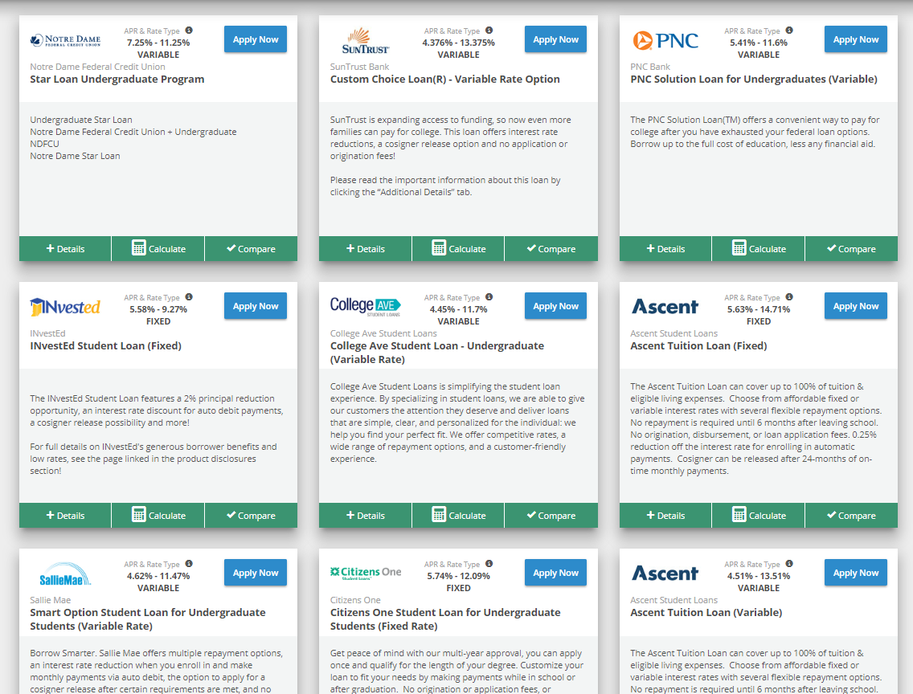
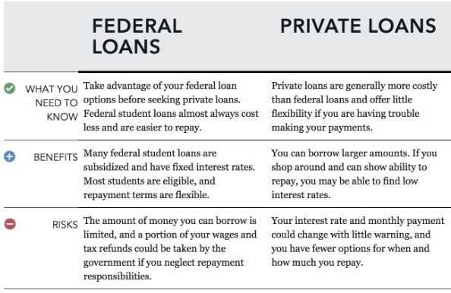
LEARNING ABOUT LOANS – PRIVATE LOANS
Meet with school to see if they have a lender list or lender comparison tool

Slide 34
COLLEGE BILLING - WHEN & HOW TO PAY
-Fall bill usually sent in July or August. May be electronic or mailed. May go to just the student or also individuals the student sets up as authorized delegate.
-Will show DIRECT costs, but not INDIRECT costs. Direct costs could include Tuition, Required Fees, On-Campus Housing and Meal Plans.
-Should show the financial aid already applied, if you have done all to-do items (e.g. loan applications, MPNs, loan counseling).
-Will NOT list work-study funds because student must earn gradually by working.

Slide 35
COLLEGE BILLING - (CONT.)
-Will show either a refund (more aid than charges) or an amount due (more charges than aid.) If amount owed, will show a due date.
-Many schools will expect the entire amount due for that semester at once, for example, by September 15, or even before the start of the semester.
-Schools may have payment plan options that allow you to pay over the semester or year. Most will have a fee.
-Can mail in a payment or make online payments. Be careful of paying with a credit card, there may be additional fees.

Slide 36
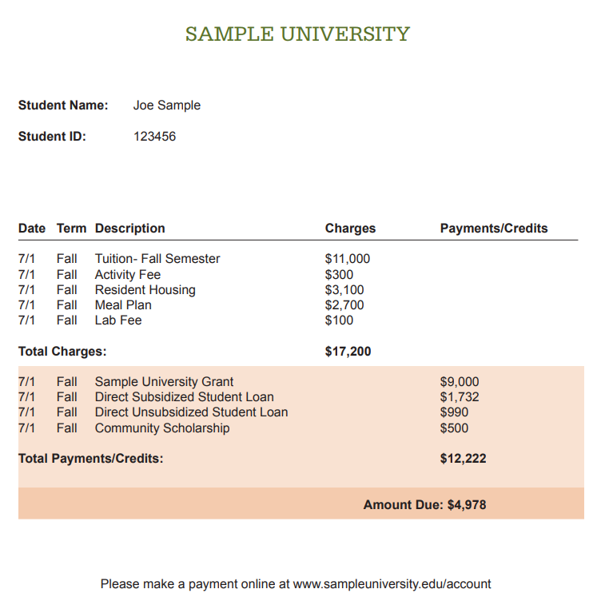
Research costs before you go
If I don’t pay on time?
Purchasing books
COLLEGE BILLING DETAILS
Don’t wait until orientation to decide if you can afford to attend. Be proactive if you cannot pay the amount due – payment plan, additional aid.
Depending on the school: dropped from classes, late fees, enrollment hold, removed from housing, collections.
Use financial aid refund, charge to school account, book advance/voucher.

Slide 37
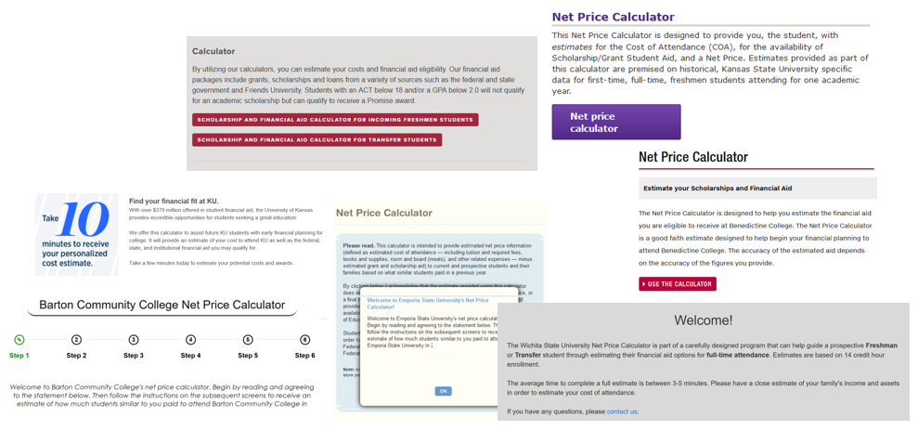
RESOURCES: NET PRICE CALCULATOR

Slide 38
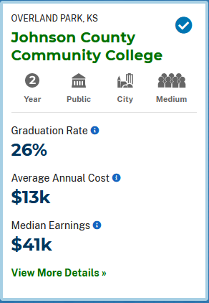
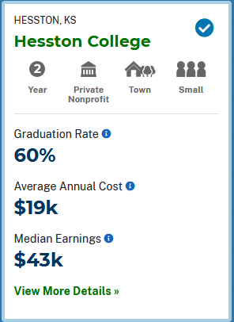
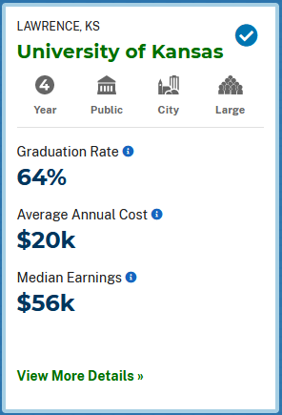
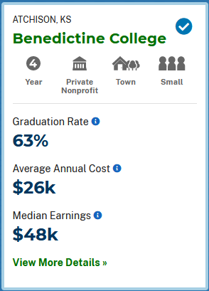
RESOURCES: COLLEGE SCORECARD
COLLEGESCORECARD.ED.GOV

Slide 39
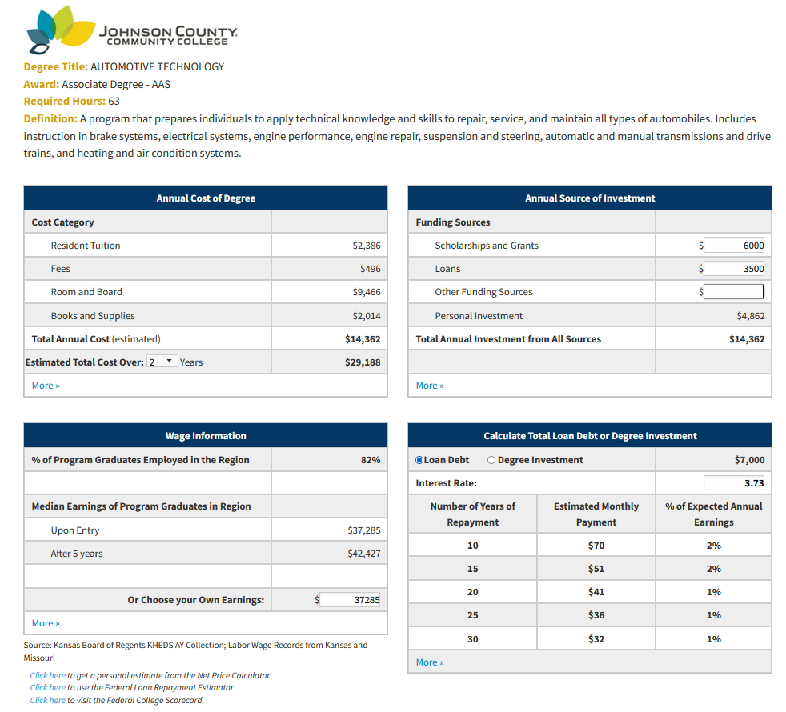
RESOURCES: KANSAS DEGREE STATS
KSDEGREESTATS.ORG

Slide 40
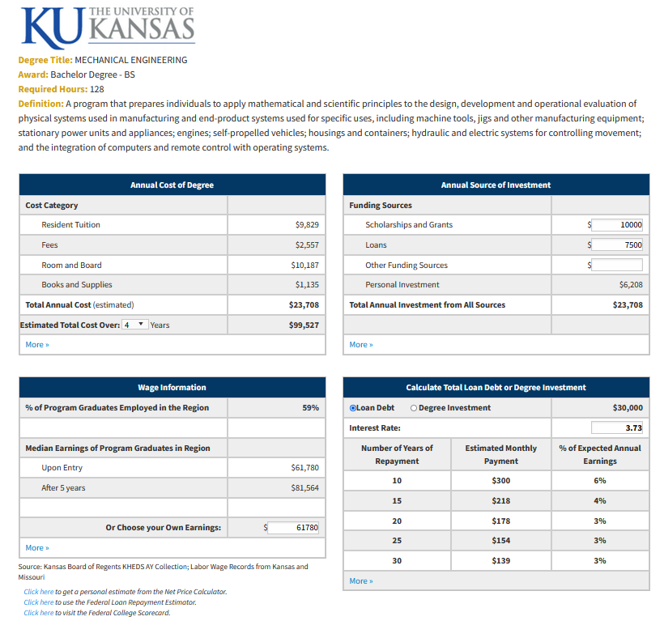
RESOURCES: KANSAS DEGREE STATS
KSDEGREESTATS.ORG

Slide 41
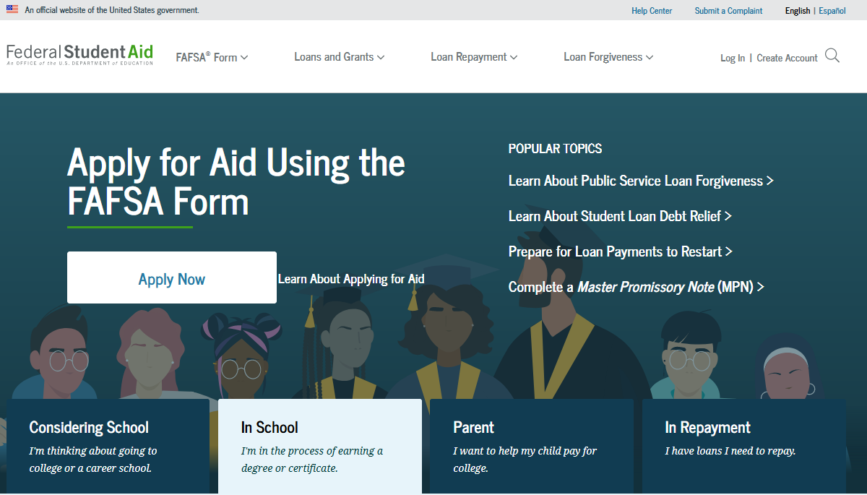
RESOURCES: FEDERAL STUDENT AID
STUDENTAID.GOV

Slide 42
Financial Literacy
WE must give the students the knowledge they need to function before they need the skill
Leticia Gradington MBA

Slide 43
Why Is Financial Education Important
The numbers tell the story!
We lose more students to credit card debt than we do for academic failure.
Students are making financial decisions that will impact them for the rest of their life.
College is not expensive the choice that student make financially determine their success or failure in the educational process.

Slide 44
Financial Literacy
The average person makes six to ten money decisions a day!

Slide 45
Decisions are being made...
Some of the decisions being made by students are unguided because they do not understand the importance of personal finance

Slide 46
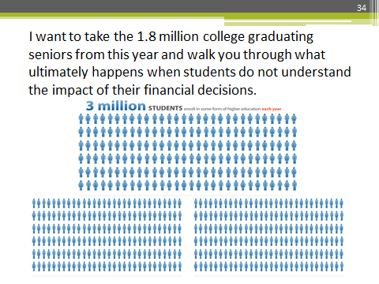
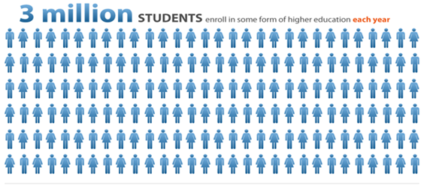
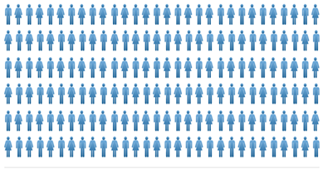
I want to take the 1.8 million college graduating seniors from this year and walk you through what ultimately happens when students do not understand the impact of their financial decisions

Slide 47
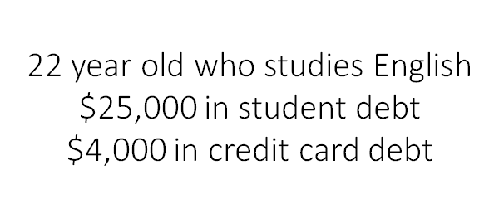
Decisions are being made...

Slide 48
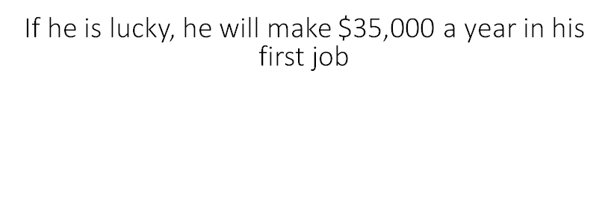
Decisions are being made...

Slide 49
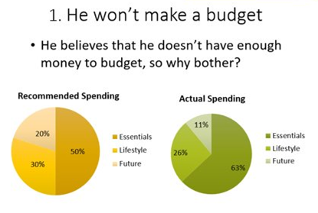
Decisions are being made...

Slide 50
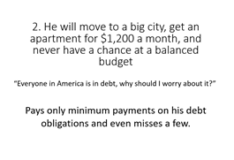
Decisions are being made...

Slide 51
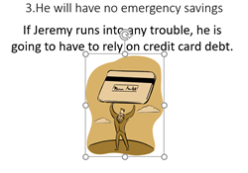
Decisions are being made...

Slide 52
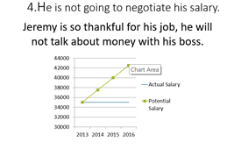
Decisions are being made...

Slide 53
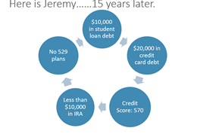
Decisions are being made...

Slide 54
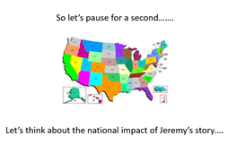
Decisions are being made...

Slide 55
Decisions are being made...

Slide 56
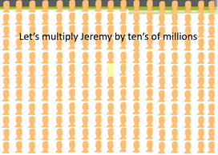
Decisions are being made...

Slide 57
Decisions are being made...

Slide 58
College Financial Planning!
College Financial Planning is the Key!
The quality of the questions we ask our students assist us in planning their success.
Let's help our students plan their financial education.
People who plan to fail, they Fail to Plan.

Slide 59
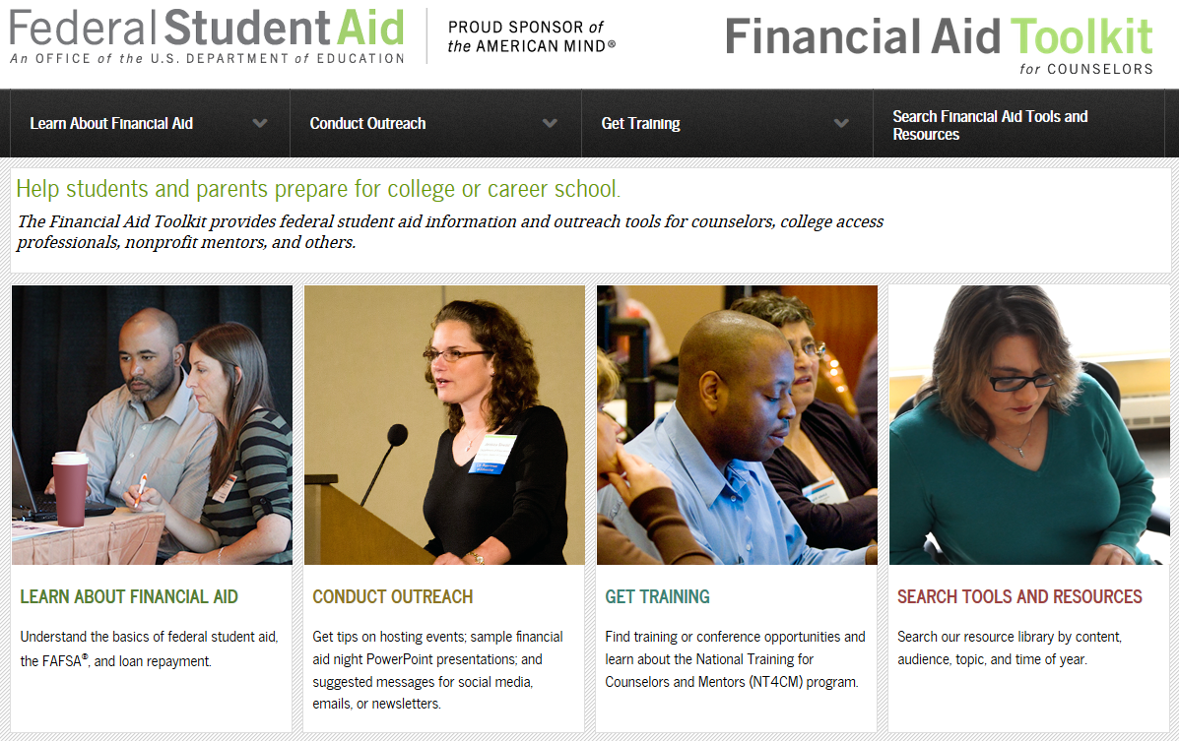
RESOURCES: FINANCIAL AID TOOLKIT
FINANCIALAIDTOOLKIT.ED.GOV

Slide 60
FUTURE TRAININGS
There are HUGE changes coming to the FAFSA for the 2024-2025 academic year. Continue to check kasfaa.org > High School Resources > Counselor Training in late August, early September for 2024-2025 training dates.
https://kasfaa.org/counselor_training.php

Slide 61
QUESTIONS?
Thank-you for attending!
Please submit evaluations!
TONA STONE-BENEDICTINE COLLEGE
SCOTT SPONHOLTZ-UNIVERSITY OF KANSAS MEDICAL CENTER
LETICIA GRADINGTON-UNIVERSITY OF KANSAS
DANIELLE SULLIVAN-JOHNSON COUNTY COMMUNITY COLLEGE
v

